Slide 1

Cryptography
Dr. Tran The Son
Notes:
Lecture slides prepared for “Cryptography and Network Security”, 6/e, by William Stallings, Chapter 4 – “Basic Concepts in Number Theory and Finite Fields”.

Slide 2
Chapter 6
Advanced Encryption Standard
Notes:
The Advanced Encryption Standard (AES) was published by the National Institute
of Standards and Technology (NIST) in 2001. AES is a symmetric block cipher that
is intended to replace DES as the approved standard for a wide range of applications.
Compared to public-key ciphers such as RSA, the structure of AES and most symmetric
ciphers is quite complex and cannot be explained as easily as many other cryptographic
algorithms. Accordingly, the reader may wish to begin with a simplified version
of AES, which is described in Appendix 5B. This version allows the reader to perform
encryption and decryption by hand and gain a good understanding of the working of
the algorithm details. Classroom experience indicates that a study of this simplified
version enhances understanding of AES. One possible approach is to read the chapter
first, then carefully read Appendix 5B, and then re-read the main body of the chapter.

Slide 3
Chapter 6: Outline
Finite Field Arithmetic
AES Structure
AES Transformation Functions
AES Key Expansion
An AES Example
AES Implementation
Key Terms, Review Questions, and

Slide 4
Finite Field Arithmetic
In the Advanced Encryption Standard (AES) all operations are performed on 8-bit bytes
The arithmetic operations of addition, multiplication, and division are performed over the finite field GF(2⁸)
A field is a set in which we can do addition, subtraction, multiplication, and division without leaving the set
Division is defined with the following rule:
a /b = a (b⁻¹ )
An example of a finite field (one with a finite number of elements) is the set Z_{p} consisting of all the integers {0, 1, . . . . , p - 1}, where p is a prime number and in which arithmetic is carried out modulo p
Notes:
In AES, all operations are performed on 8-bit bytes. In particular, the arithmetic
operations of addition, multiplication, and division are performed over the finite
field GF(28 ). Section 4.7 discusses such operations in some detail. For the reader
who has not studied Chapter 4, and as a quick review for those who have, this
section summarizes the important concepts.
In essence, a field is a set in which we can do addition, subtraction, multiplication,
and division without leaving the set. Division is defined with the following
rule: a /b = a (b⁻¹ ). An example of a finite field (one with a finite number of elements)
is the set Z_{p} consisting of all the integers {0, 1, . . . . , p - 1}, where p is a prime number
and in which arithmetic is carried out modulo p .

Slide 5
Finite Field Arithmetic
If one of the operations used in the algorithm is division, then we need to work in arithmetic defined over a field
Division requires that each nonzero element have a multiplicative inverse
For convenience and for implementation efficiency we would like to work with integers that fit exactly into a given number of bits with no wasted bit patterns
Integers in the range 0 through 2^{n} – 1, which fit into an n-bit word
The set of such integers, Z₂^{n}, using modular arithmetic, is not a field
For example, the integer 2 has no multiplicative inverse in Z₂^{n}, that is, there is no integer b, such that 2b mod 2^{n} = 1
A finite field containing 2^{n} elements is referred to as GF(2^{n})
Every polynomial in GF(2^{n}) can be represented by an n-bit number
Notes:
Virtually all encryption algorithms, both conventional and public-key, involve
arithmetic operations on integers. If one of the operations used in the algorithm
is division, then we need to work in arithmetic defined over a field; this is because
division requires that each nonzero element have a multiplicative inverse. For convenience
and for implementation efficiency, we would also like to work with integers
that fit exactly into a given number of bits, with no wasted bit patterns. That is,
we wish to work with integers in the range 0 through 2^{n} - 1, which fit into an n -bit
word. Unfortunately, the set of such integers, Z₂^{n} , using modular arithmetic, is not a
field. For example, the integer 2 has no multiplicative inverse in Z₂^{n} , that is, there is
no integer b , such that 2b mod 2^{n} = 1.
There is a way of defining a finite field containing 2^{n} elements; such a field is
referred to as GF(2^{n} ).

Slide 6
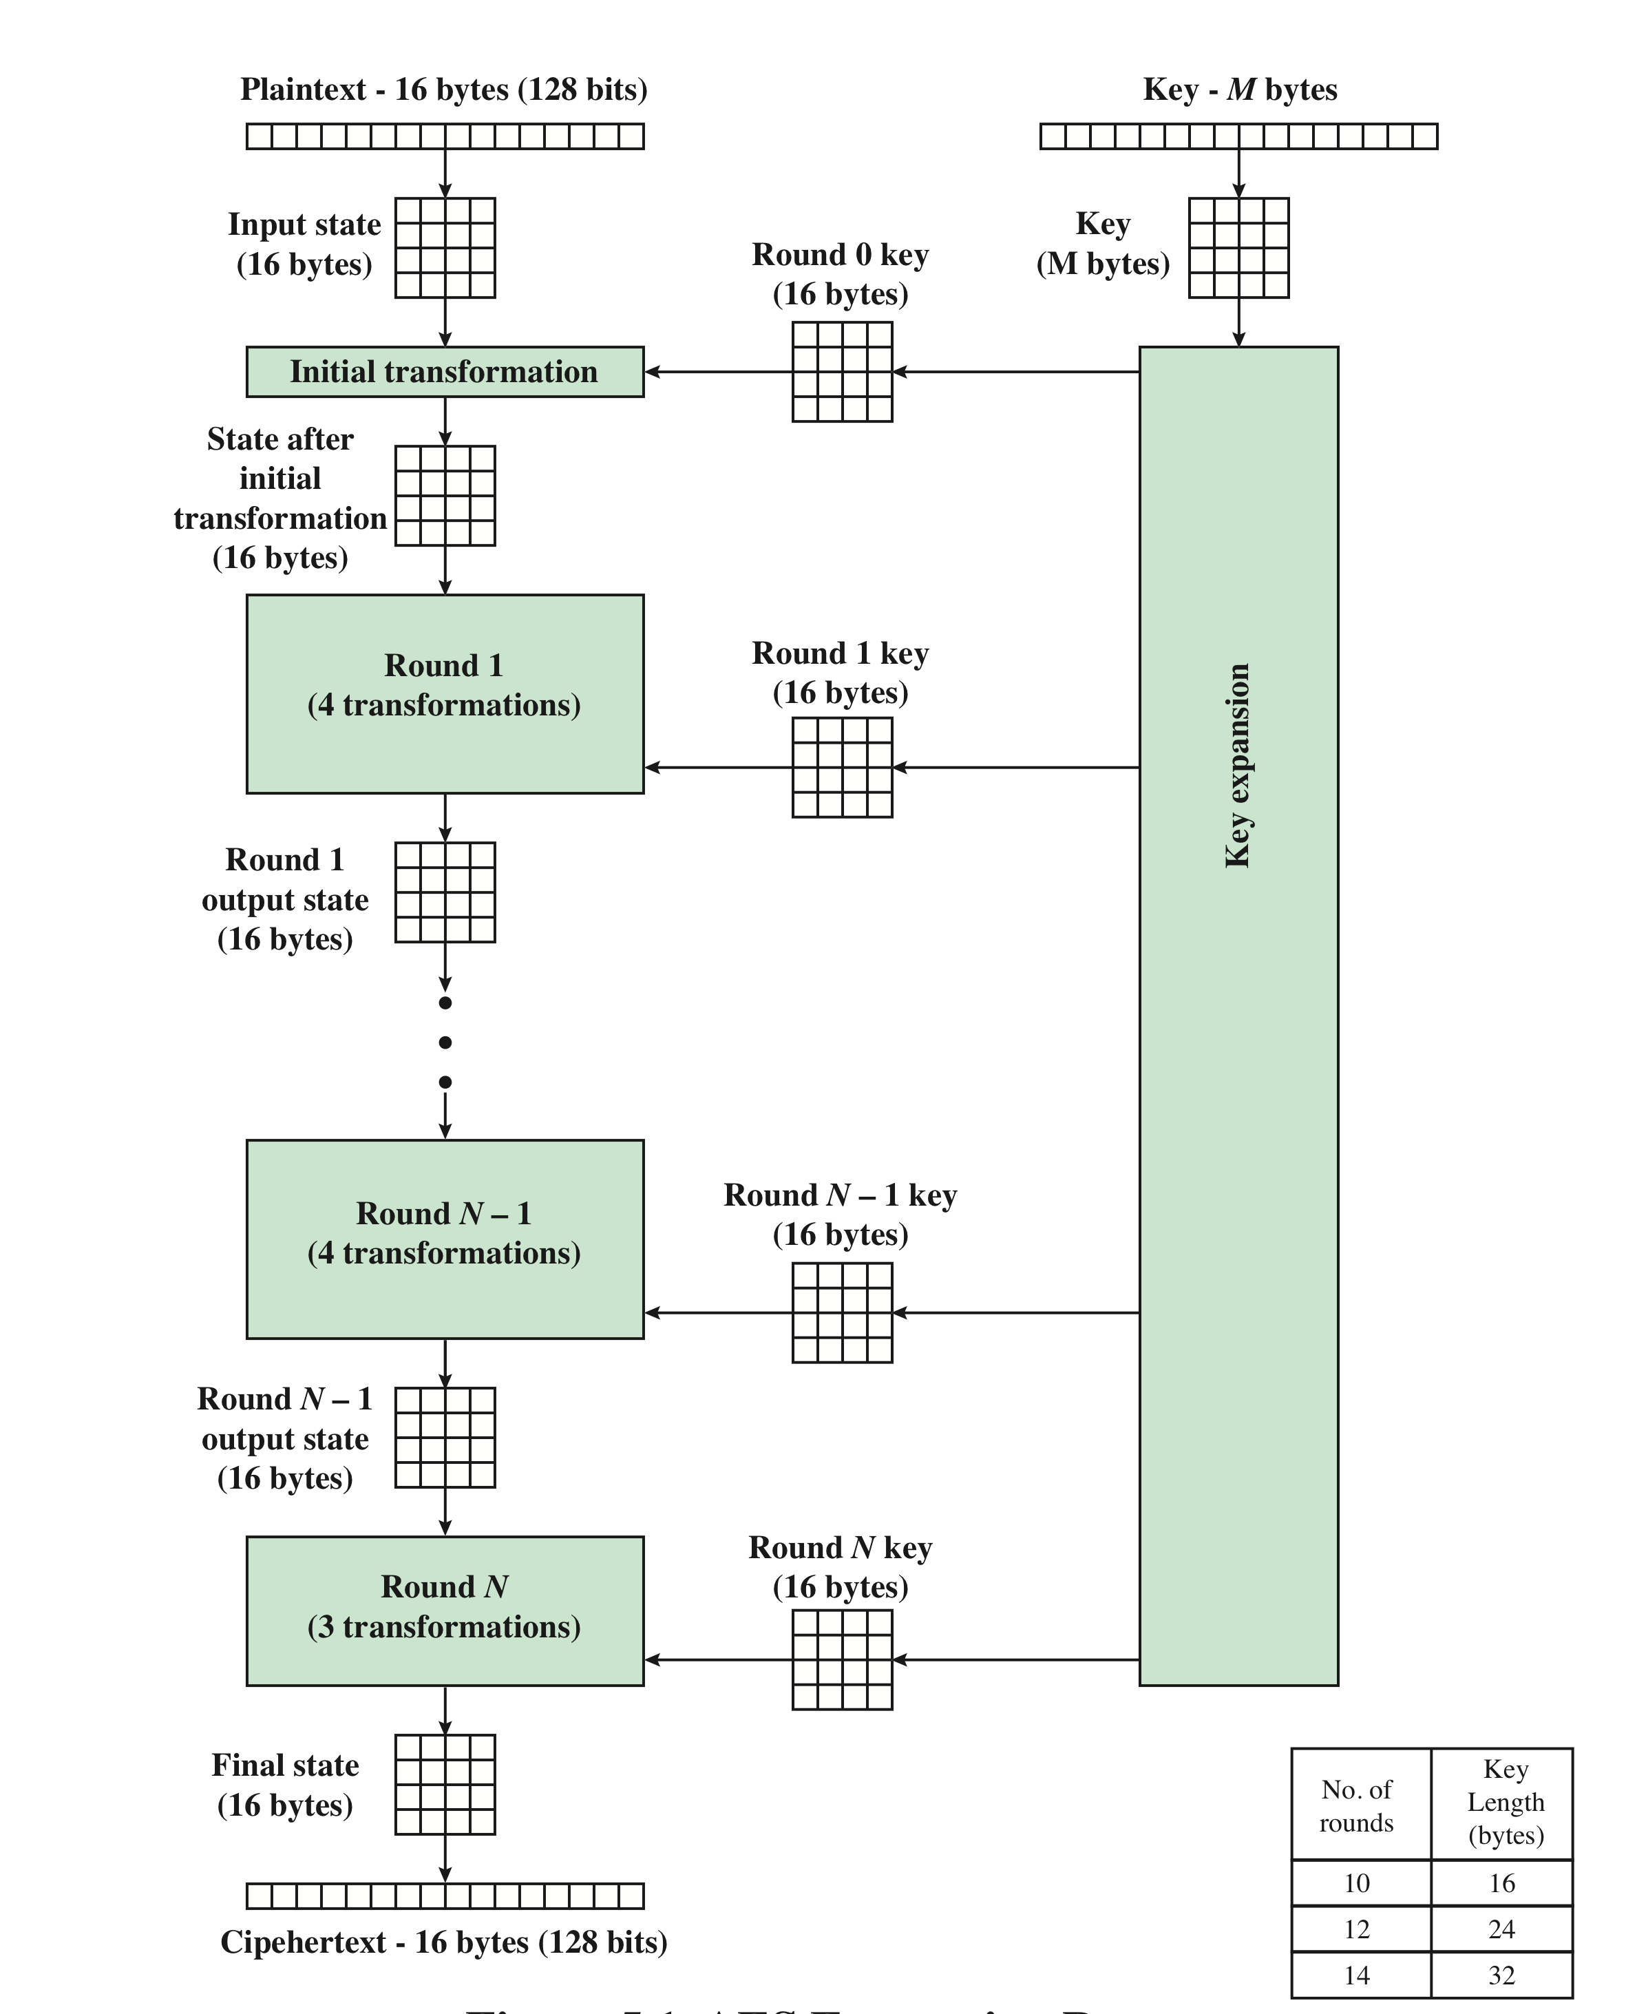
AES Encryption Process
Notes:
Figure 5.1 shows the overall structure of the AES encryption process. The cipher
takes a plaintext block size of 128 bits, or 16 bytes. The key length can be 16, 24, or
32 bytes (128, 192, or 256 bits). The algorithm is referred to as AES-128, AES-192, or
AES-256, depending on the key length.

Slide 7
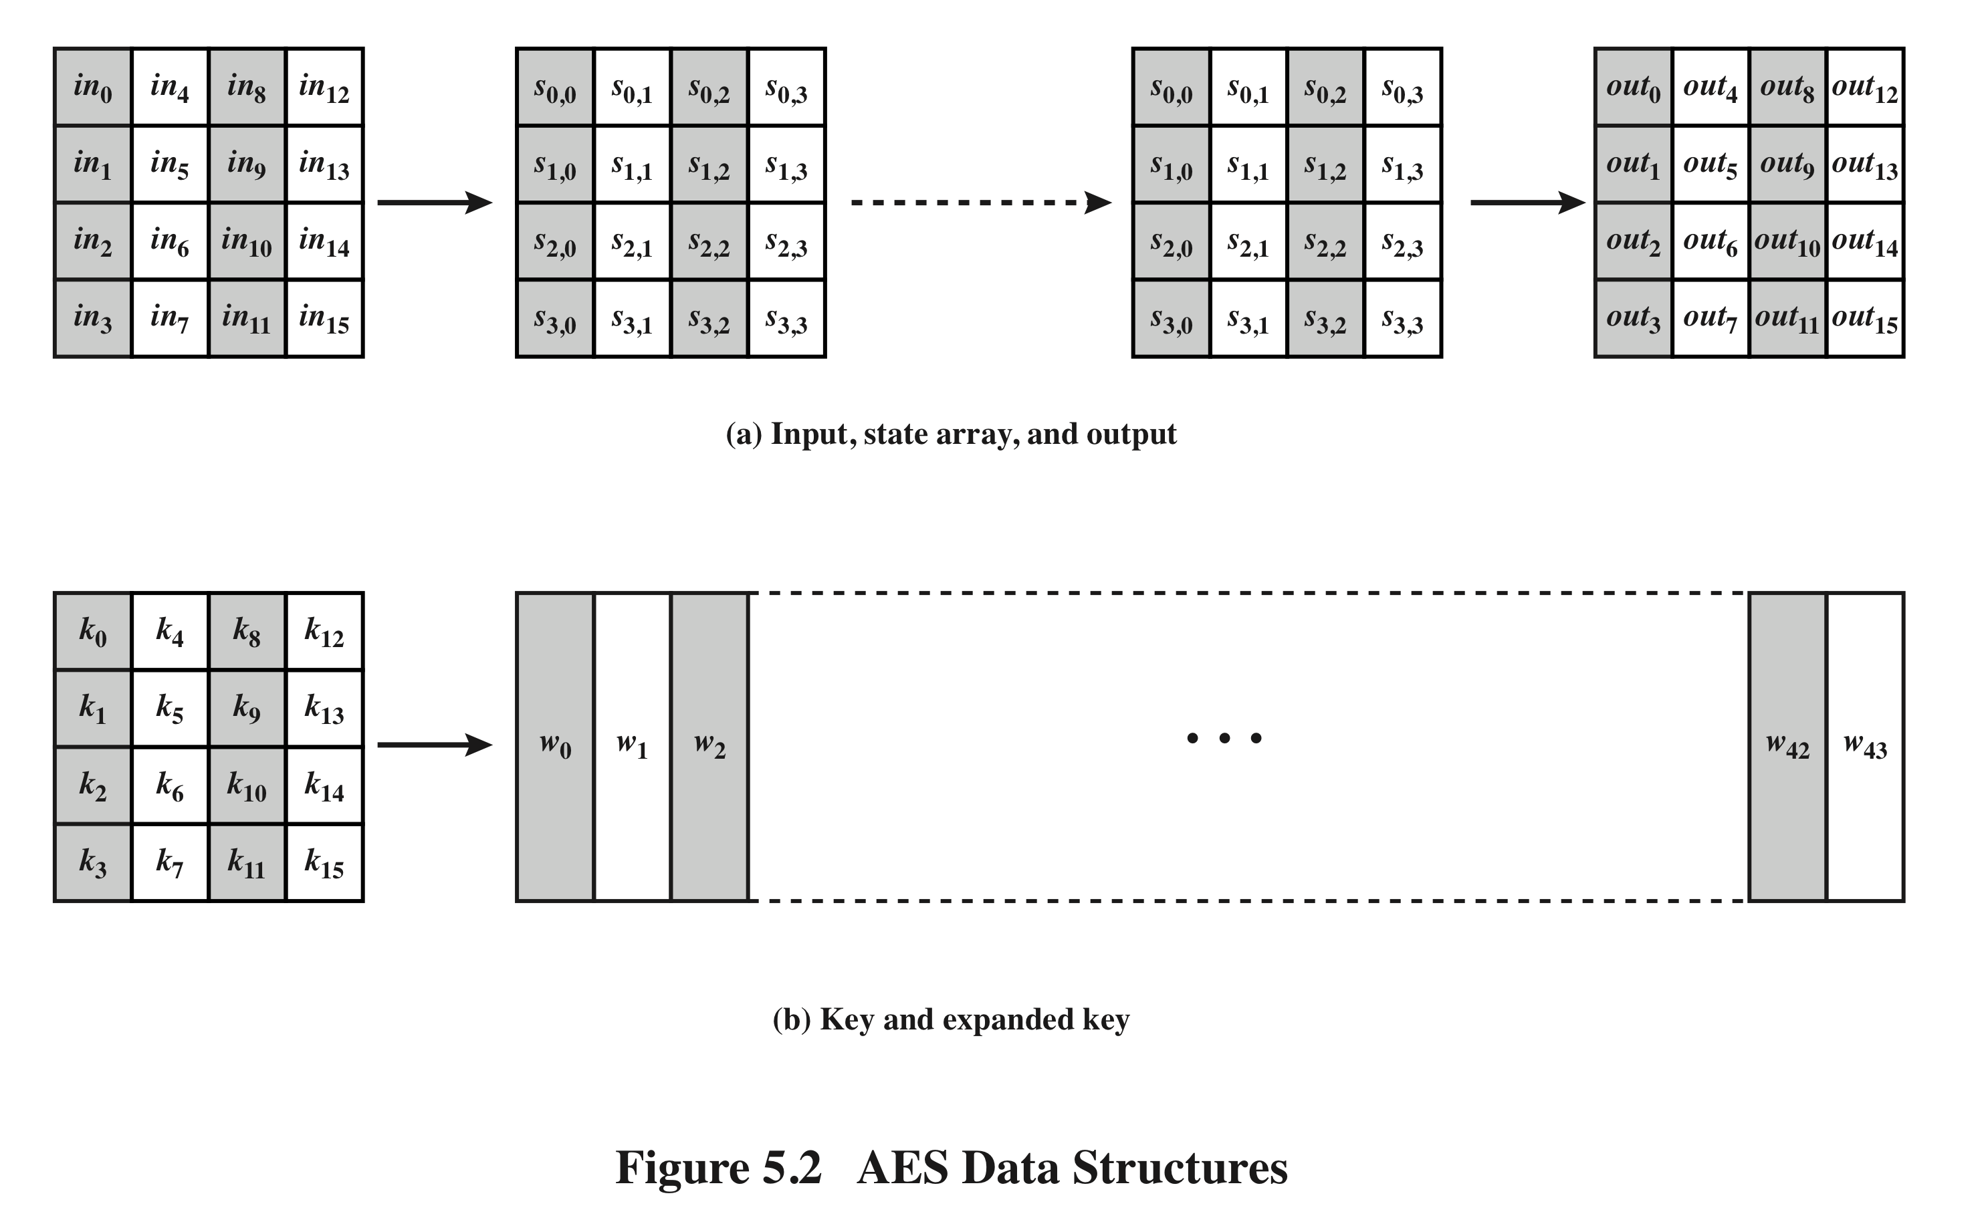
AES Data Structures
Notes:
The input to the encryption and decryption algorithms is a single 128-bit block.
In FIPS PUB 197, this block is depicted as a 4 * 4 square matrix of bytes. This
block is copied into the State array, which is modified at each stage of encryption or
decryption. After the final stage, State is copied to an output matrix. These operations
are depicted in Figure 5.2a. Similarly, the key is depicted as a square matrix of bytes.
This key is then expanded into an array of key schedule words. Figure 5.2b shows the
expansion for the 128-bit key. Each word is four bytes, and the total key schedule
is 44 words for the 128-bit key. Note that the ordering of bytes within a matrix is by
column. So, for example, the first four bytes of a 128-bit plaintext input to the encryption
cipher occupy the first column of the in matrix, the second four bytes occupy the
second column, and so on. Similarly, the first four bytes of the expanded key, which
form a word, occupy the first column of the w matrix.

Slide 8
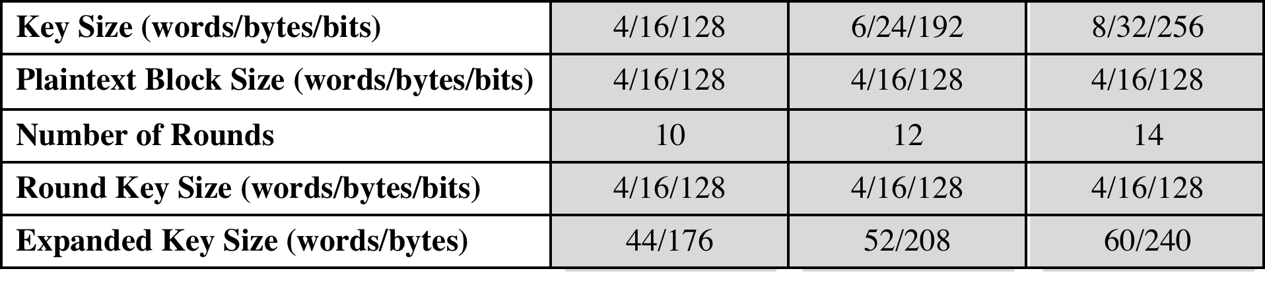
Table 5.1 AES Parameters
Notes:
The cipher consists of N rounds, where the number of rounds depends on the
key length: 10 rounds for a 16-byte key, 12 rounds for a 24-byte key, and 14 rounds
for a 32-byte key (Table 5.1). The first N - 1 rounds consist of four distinct transformation
functions: SubBytes, ShiftRows, MixColumns, and AddRoundKey, which are
described subsequently. The final round contains only three transformations, and
there is a initial single transformation (AddRoundKey) before the first round, which
can be considered Round 0. Each transformation takes one or more 4 * 4 matrices
as input and produces a 4 * 4 matrix as output. Figure 5.1 shows that the output of
each round is a 4 * 4 matrix, with the output of the final round being the ciphertext.
Also, the key expansion function generates N + 1 round keys, each of which is a distinct
4 * 4 matrix. Each round key serves as one of the inputs to the AddRoundKey
transformation in each round.

Slide 9
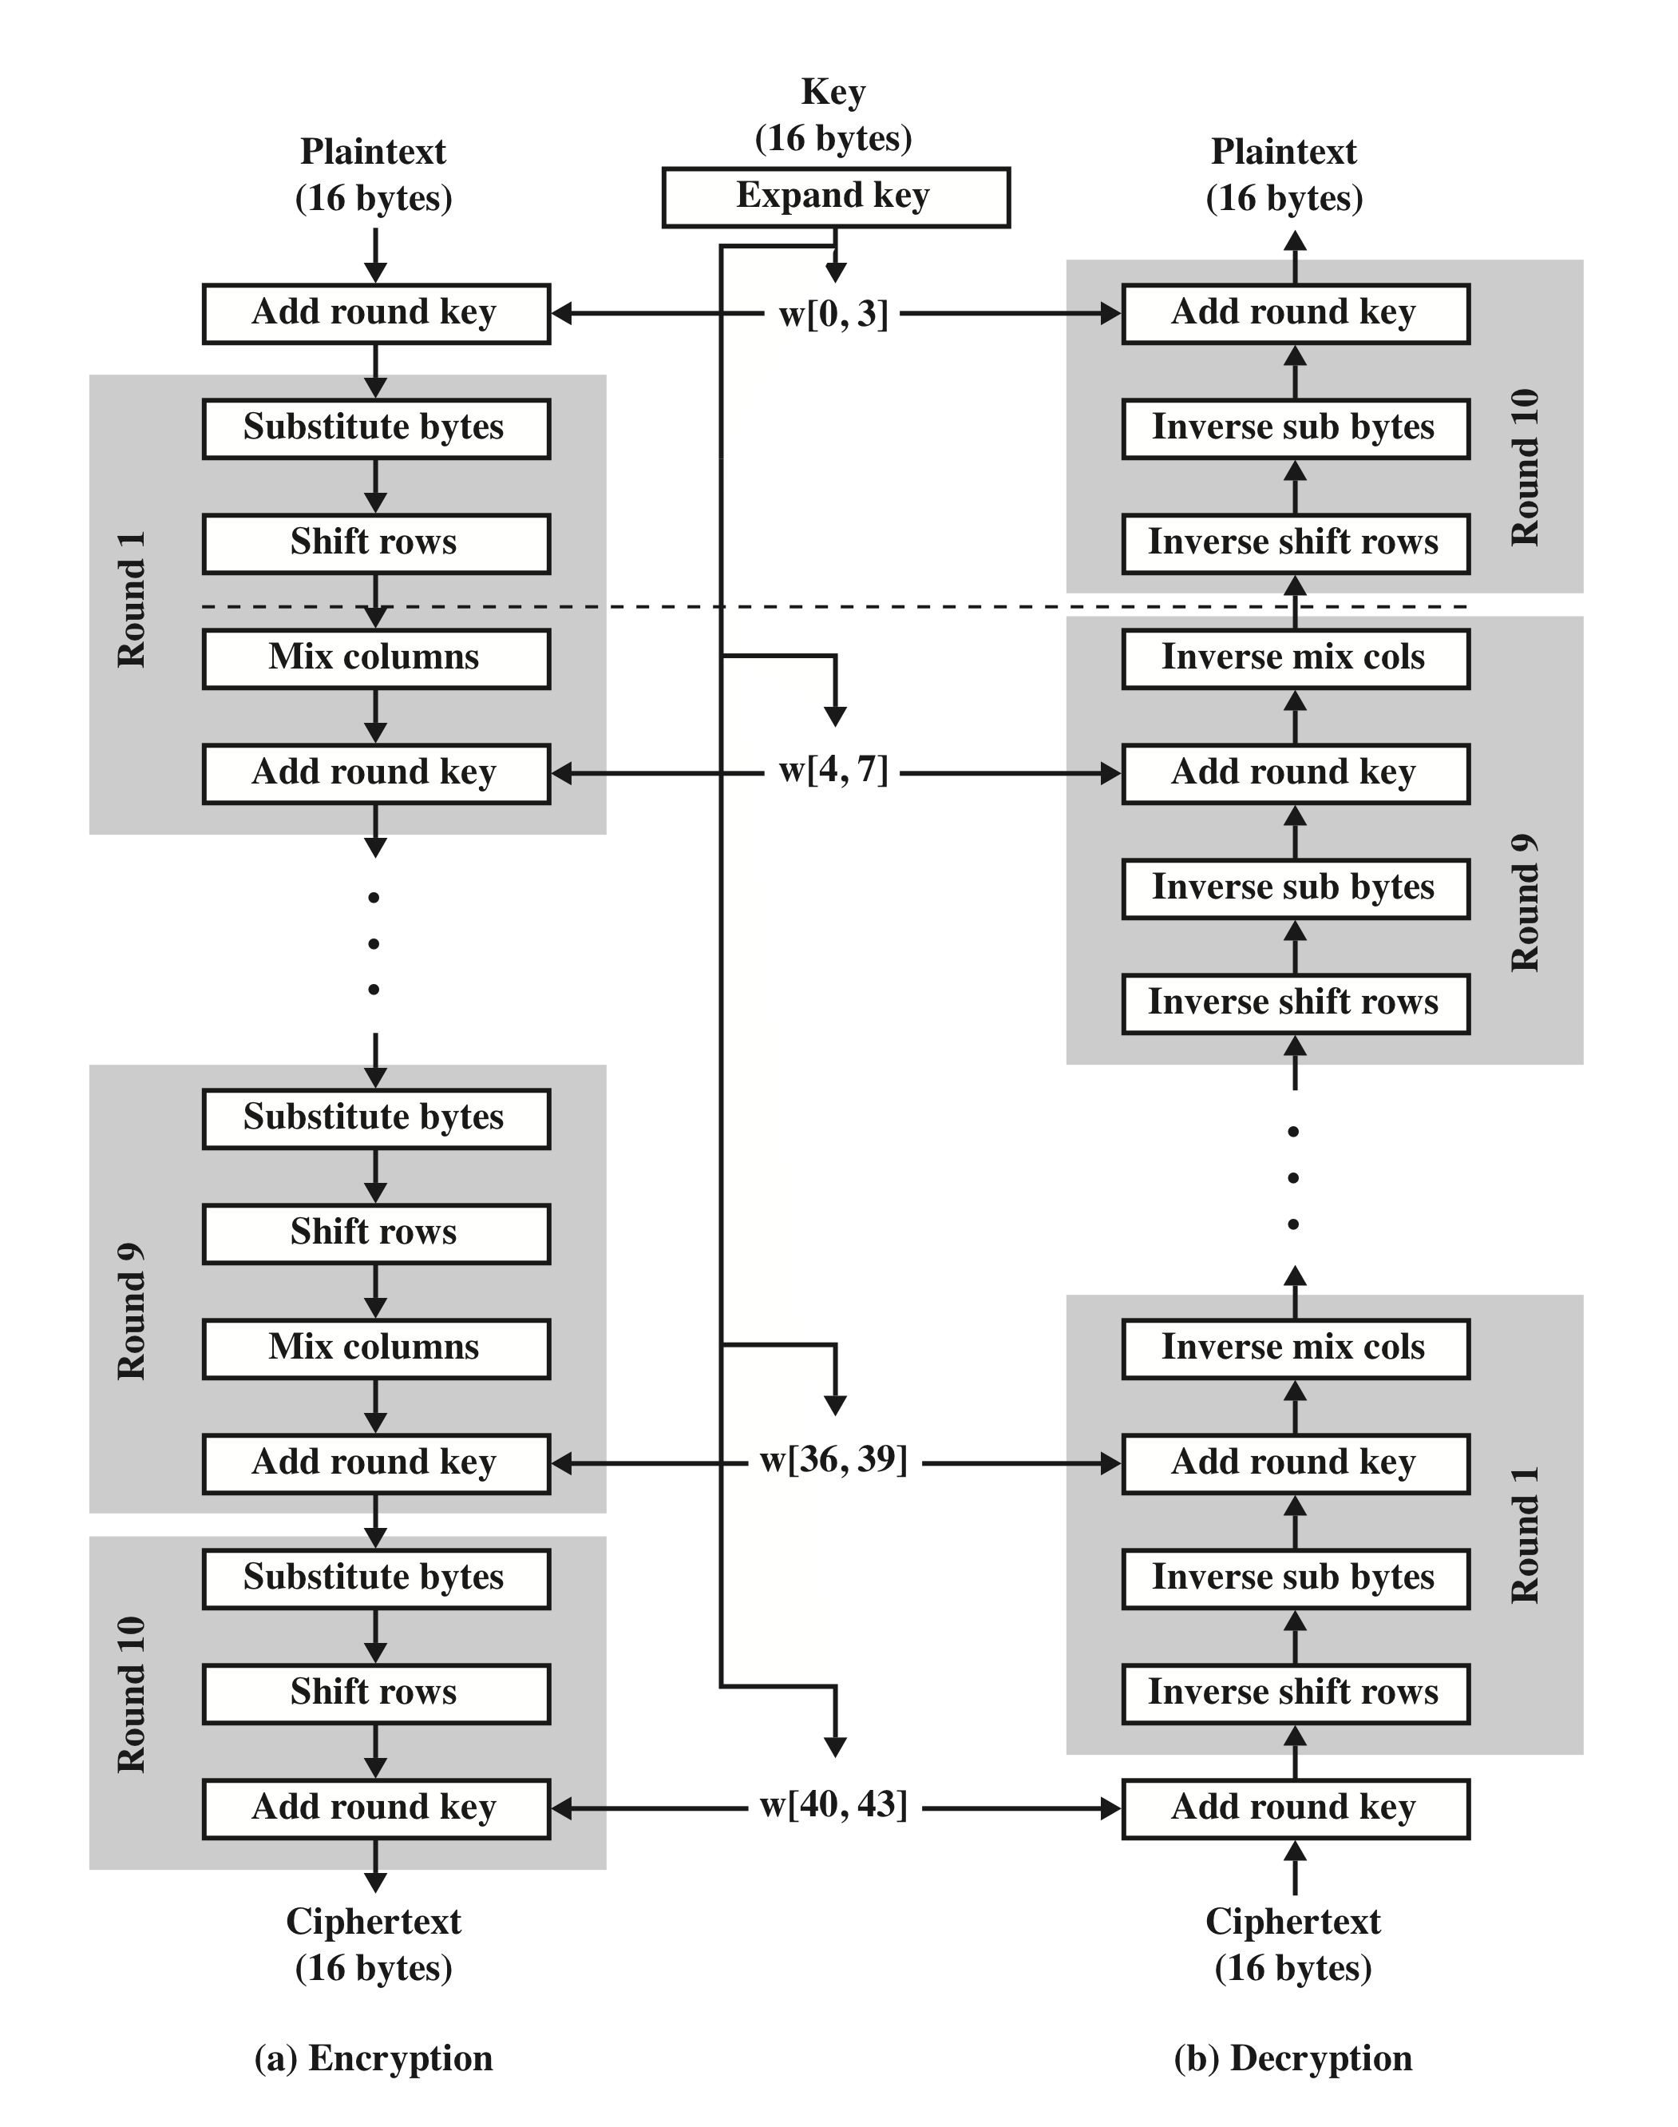
AES Encryption and Decryption
Notes:
Figure 5.3 shows the AES cipher in more detail, indicating the sequence of transformations
in each round and showing the corresponding decryption function. As was
done in Chapter 3, we show encryption proceeding down the page and decryption
proceeding up the page.

Slide 10
Detailed Structure
Processes the entire data block as a single matrix during each round using substitutions and permutation
The key that is provided as input is expanded into an array of forty-four 32-bit words, w[i]
The cipher begins and ends with an AddRoundKey stage.
Can view the cipher as alternating operations of XOR encryption (AddRoundKey) of a block, followed by scrambling of the block (the other three stages), followed by XOR encryption, and so on
Each stage is easily reversible. For the AddRoundKey stage, the inverse is achieved by XORing the same round key (A ⊕ B ⊕ B = A).
The decryption algorithm makes use of the expanded key in reverse order, however the decryption algorithm is not identical to the encryption algorithm.
State is the same for both encryption and decryption.
Final round of both encryption and decryption consists of only three stages.
Four different stages are used:
Substitute bytes – uses an S-box to perform a byte-by-byte substitution of the block
ShiftRows – a simple permutation
MixColumns – a substitution that makes use of arithmetic over GF(2⁸)
AddRoundKey – a simple bitwise XOR of the current block with a portion of the expanded key
Notes:
Before delving into details, we can make several comments about the overall
AES structure.
1. One noteworthy feature of this structure is that it is not a Feistel structure.
Recall that, in the classic Feistel structure, half of the data block is used to
modify the other half of the data block and then the halves are swapped. AES
instead processes the entire data block as a single matrix during each round
using substitutions and permutation.
2. The key that is provided as input is expanded into an array of forty-four 32-bit
words, w [i ]. Four distinct words (128 bits) serve as a round key for each round;
these are indicated in Figure 5.3.
3. Four different stages are used, one of permutation and three of substitution:
• Substitute bytes: Uses an S-box to perform a byte-by-byte substitution of
the block
• ShiftRows: A simple permutation
• MixColumns: A substitution that makes use of arithmetic over GF(28 )
• AddRoundKey: A simple bitwise XOR of the current block with a portion
of the expanded key
4. The structure is quite simple. For both encryption and decryption, the
cipher begins with an AddRoundKey stage, followed by nine rounds that each
includes all four stages, followed by a tenth round of three stages.
5. Only the AddRoundKey stage makes use of the key. For this reason, the cipher
begins and ends with an AddRoundKey stage. Any other stage, applied at the
beginning or end, is reversible without knowledge of the key and so would add
no security.
6. The AddRoundKey stage is, in effect, a form of Vernam cipher and by itself
would not be formidable. The other three stages together provide confusion,
diffusion, and nonlinearity, but by themselves would provide no security
because they do not use the key. We can view the cipher as alternating operations
of XOR encryption (AddRoundKey) of a block, followed by scrambling
of the block (the other three stages), followed by XOR encryption, and so on.
This scheme is both efficient and highly secure.
7. Each stage is easily reversible. For the Substitute Byte, ShiftRows, and
MixColumns stages, an inverse function is used in the decryption algorithm.
For the AddRoundKey stage, the inverse is achieved by XORing the same
round key to the block.
8. As with most block ciphers, the decryption algorithm makes use of the
expanded key in reverse order. However, the decryption algorithm is not
identical to the encryption algorithm. This is a consequence of the particular
structure of AES.
9. Once it is established that all four stages are reversible, it is easy to verify
that decryption does recover the plaintext. Figure 5.3 lays out encryption
and decryption going in opposite vertical directions. At each horizontal point
(e.g., the dashed line in the figure), State is the same for both encryption and
decryption.
10. The final round of both encryption and decryption consists of only three stages.
Again, this is a consequence of the particular structure of AES and is required
to make the cipher reversible.

Slide 11
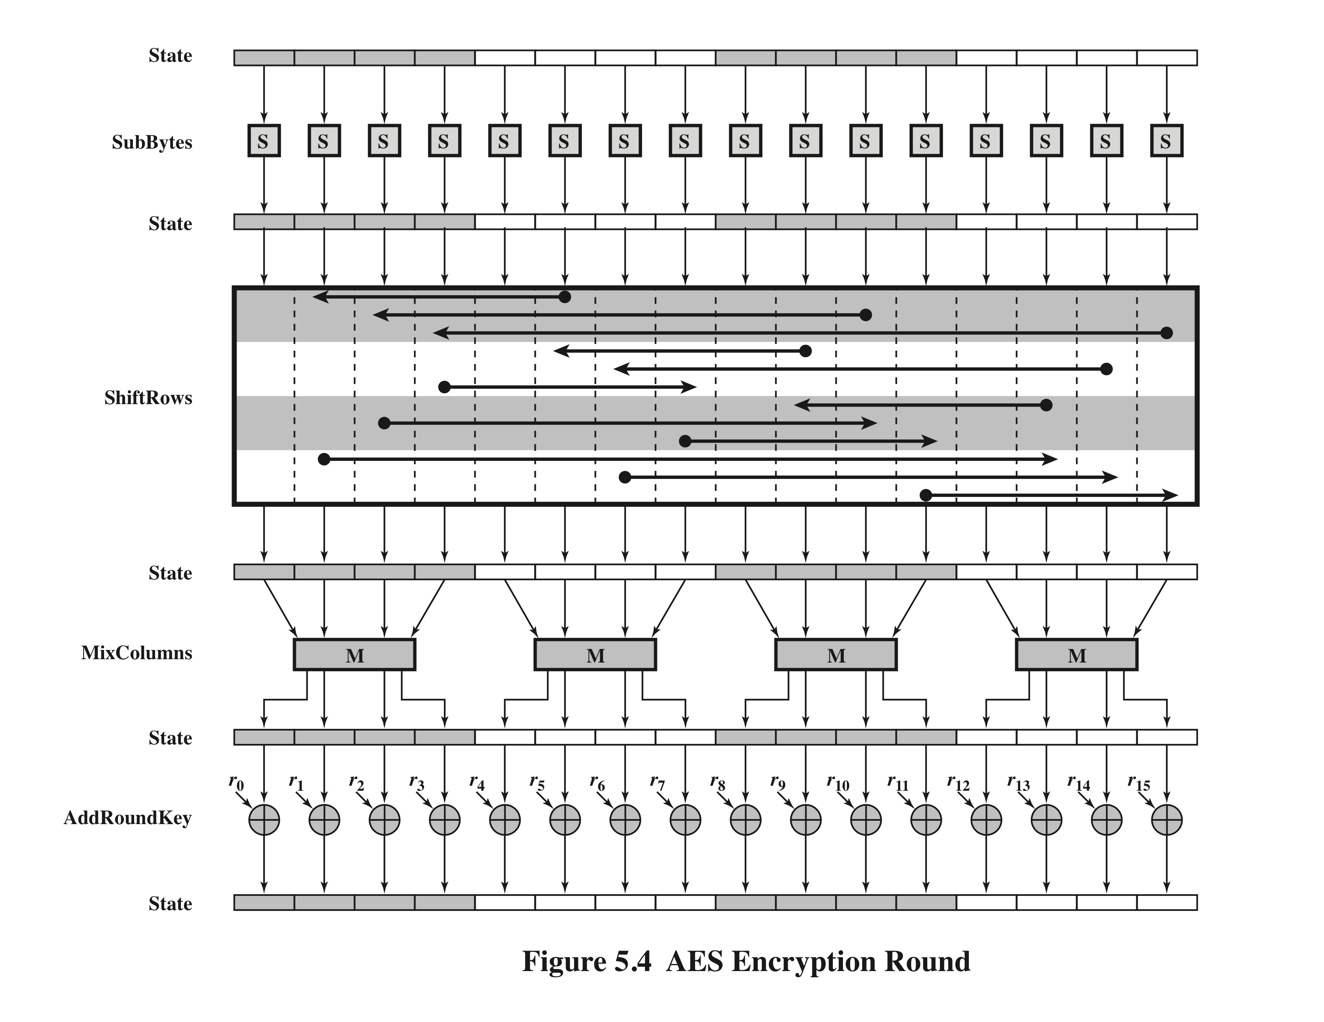
Notes:
Figure 5.4 depicts the structure of a full encryption round.

Slide 12
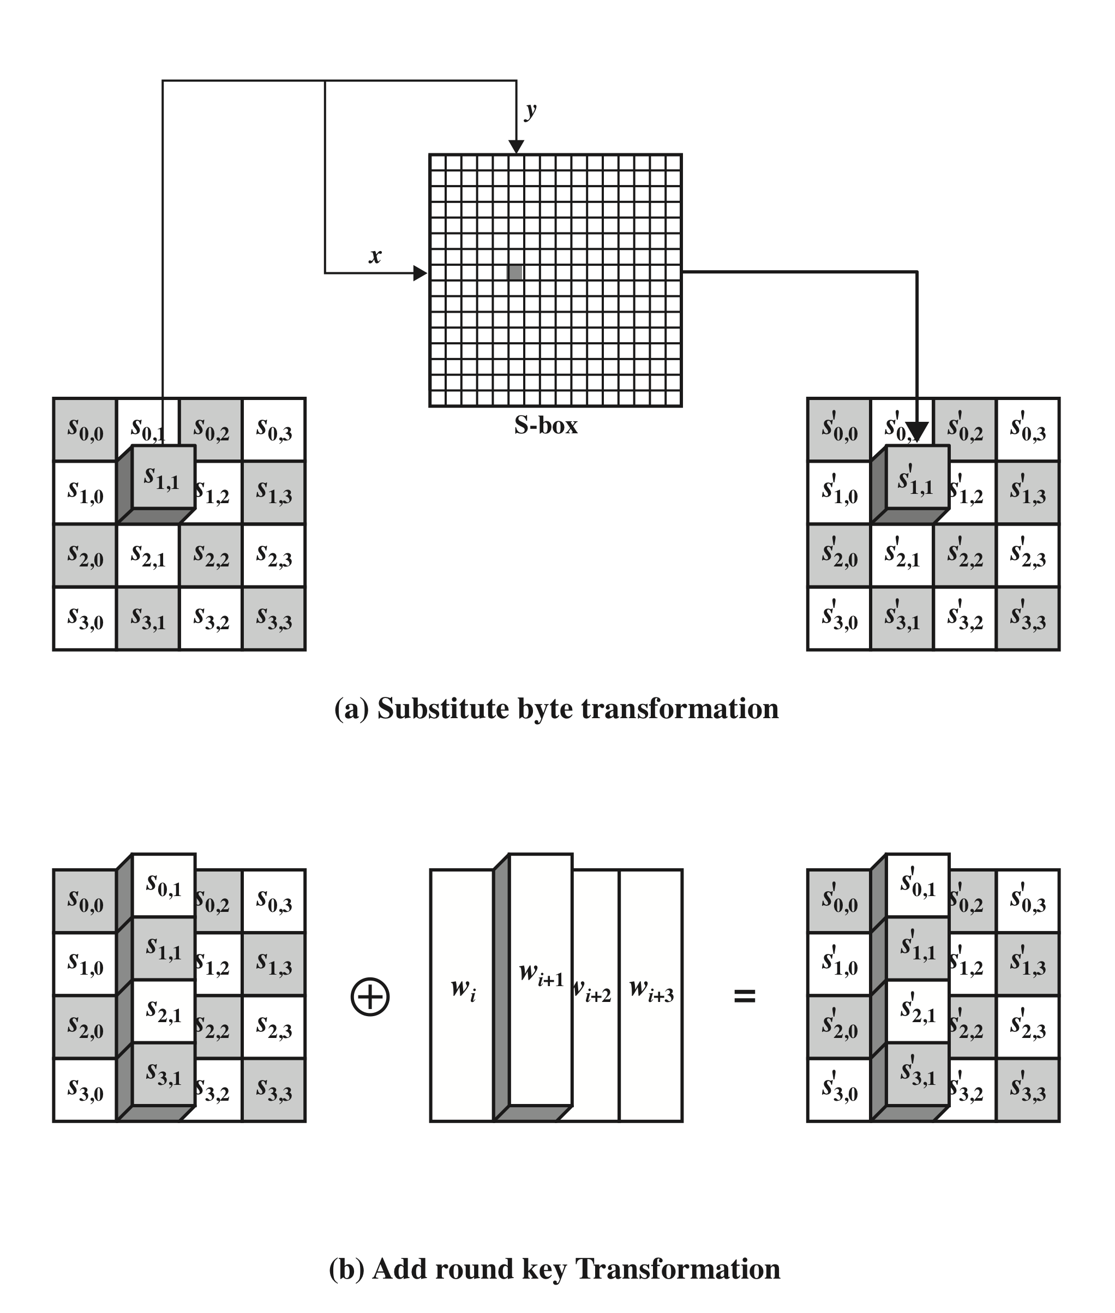
AES Byte Level Operations
AES defines a 16 * 16 matrix of byte values, called an S-box
The leftmost 4 bits of the byte are used as a row value and the rightmost 4 bits are used as a column value
Notes:
The forward substitute byte transformation , called SubBytes, is a simple table lookup (Figure 5.5a).

Slide 13
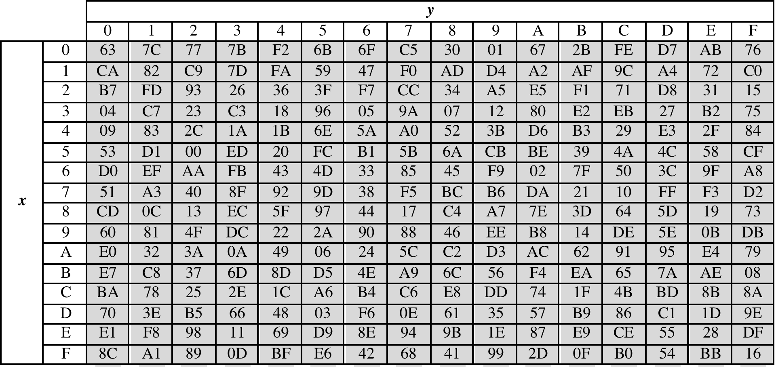
Table 5.2
(a) S-box
(Table can be found on page 139 in textbook)
Notes:
AES defines a 16 * 16 matrix of byte values, called an S-box (Table 5.2a), that contains
a permutation of all possible 256 8-bit values. Each individual byte of State
is mapped into a new byte in the following way: The leftmost 4 bits of the byte
are used as a row value and the rightmost 4 bits are used as a column value.
These row and column values serve as indexes into the S-box to select a unique
8-bit output value. For example, the hexadecimal value {95} references row 9,
column 5 of the S-box, which contains the value {2A}. Accordingly, the value {95}
is mapped into the value {2A}.

Slide 14
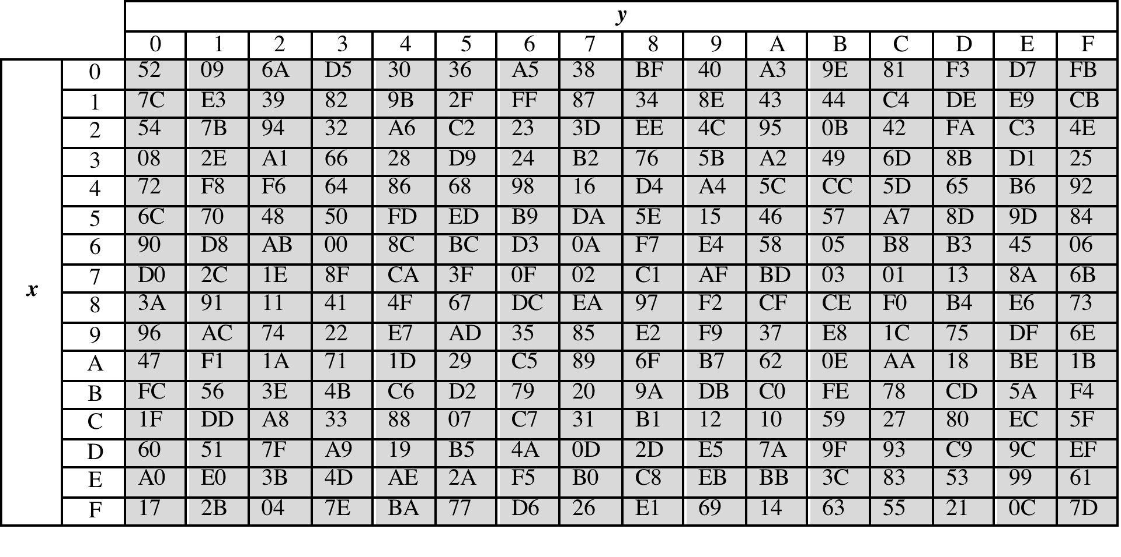
Table 5.2
(b) Inverse S-box
(Table can be found on page 139 in textbook)
Notes:
The inverse substitute byte transformation , called InvSubBytes, makes use
of the inverse S-box shown in Table 5.2b.

Slide 15
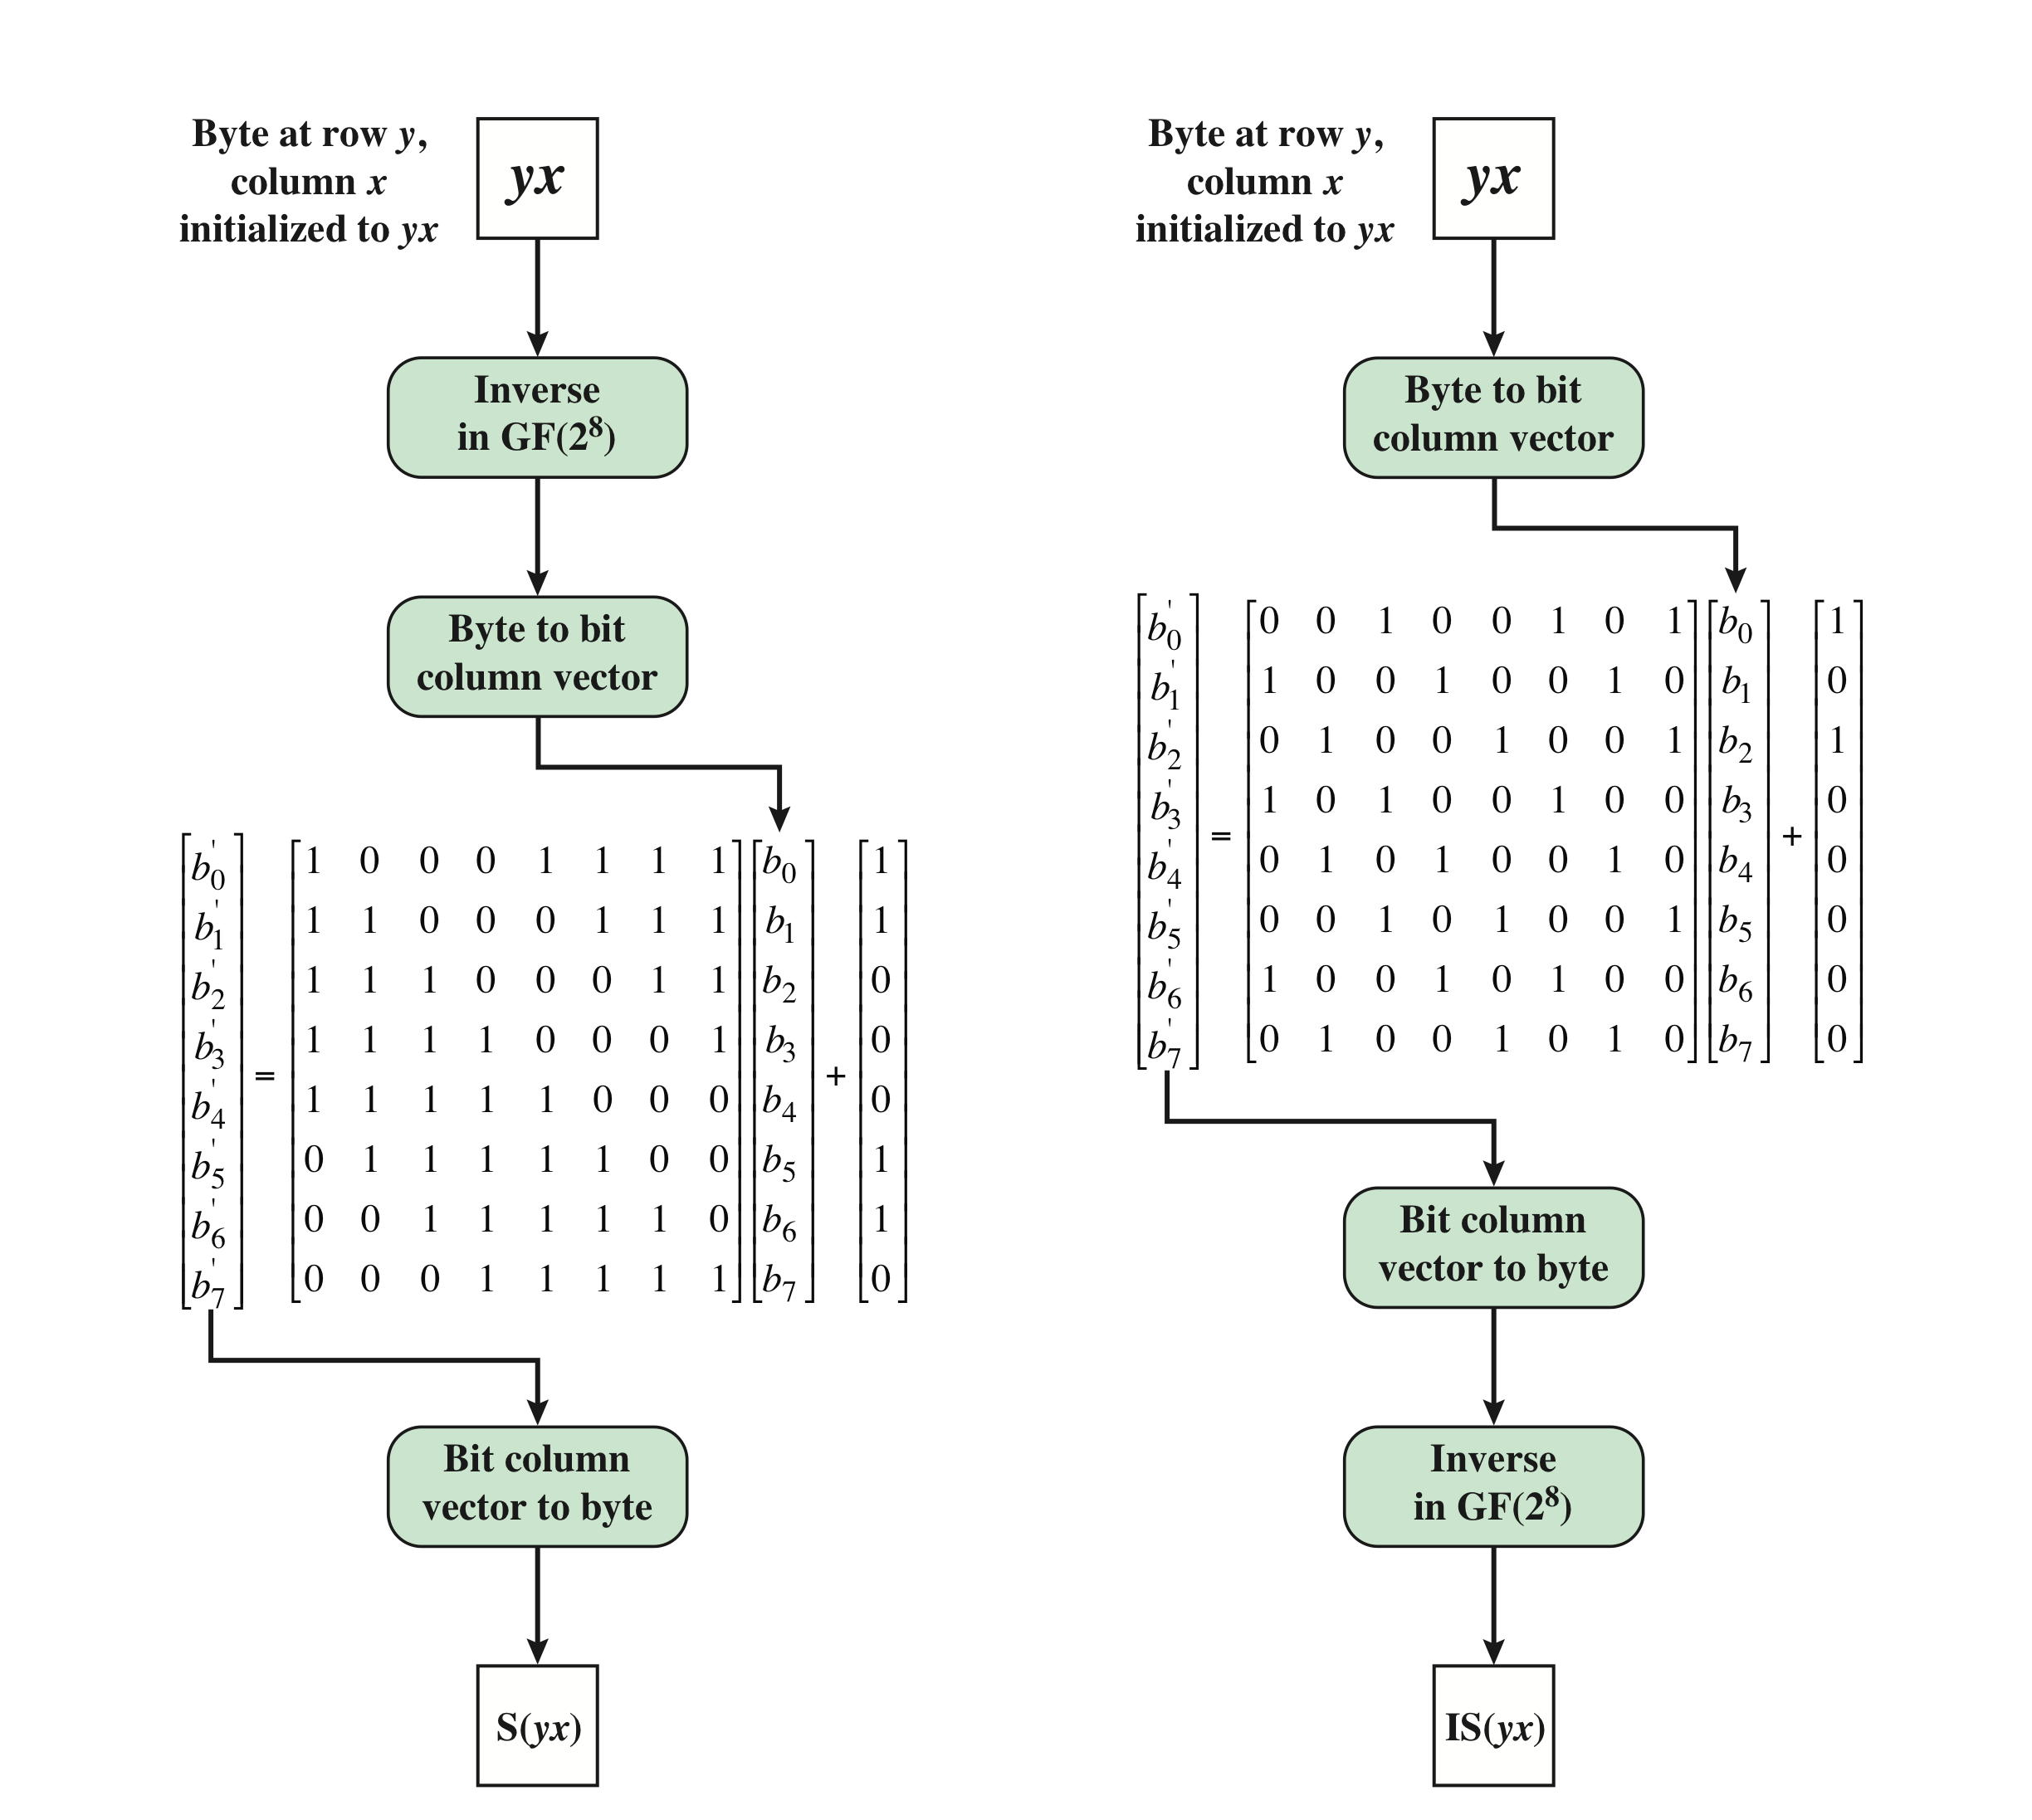
Y
D
C
X
X*Y = 1
C, D constant
YC = D
B’ = XB ⊕ C
Y (XB ⊕ C) ⊕ D = B
Notes:
Construction of S-Box and IS-Box

Slide 16
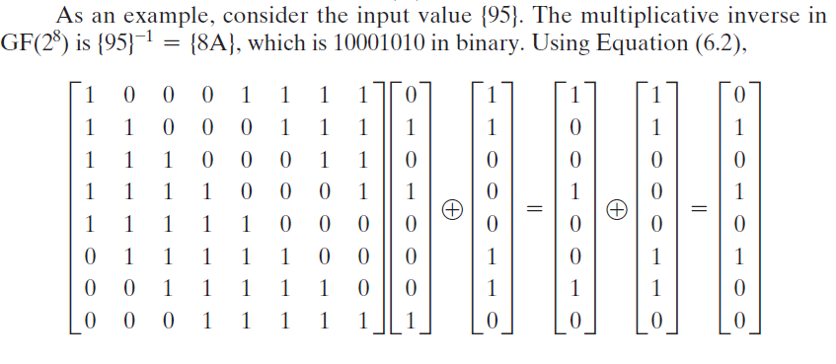
Example
= {2A}

Slide 17
S-Box Rationale
The S-box is designed to be resistant to known cryptanalytic attacks
The Rijndael developers sought a design that has a low correlation between input bits and output bits and the property that the output is not a linear mathematical function of the input
The nonlinearity is due to the use of the multiplicative inverse
Notes:
The S-box is designed to be resistant to known cryptanalytic attacks.
Specifically, the Rijndael developers sought a design that has a low correlation
Between input bits and output bits and the property that the output is not a linear
mathematical function of the input [DAEM01]. The nonlinearity is due to the use
of the multiplicative inverse.

Slide 18
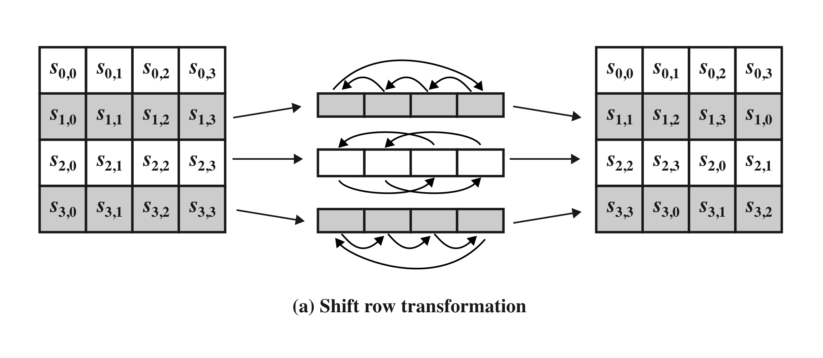
Shift Row Transformation
Figure 5.7 AES Row and Column Operations
(Figure can be found on page 144 in textbook)
Notes:
The forward shift row transformation ,
called ShiftRows, is depicted in Figure 5.7a. The first row of State is not altered. For
the second row, a 1-byte circular left shift is performed. For the third row, a 2-byte
circular left shift is performed. For the fourth row, a 3-byte circular left shift is performed.
The following is an example of ShiftRows.
The inverse shift row transformation , called InvShiftRows, performs the circular
shifts in the opposite direction for each of the last three rows, with a 1-byte
circular right shift for the second row, and so on.

Slide 19
Shift Row Rationale
More substantial than it may first appear
The State, as well as the cipher input and output, is treated as an array of four 4-byte columns
On encryption, the first 4 bytes of the plaintext are copied to the first column of State, and so on
The round key is applied to State column by column
Thus, a row shift moves an individual byte from one column to another, which is a linear distance of a multiple of 4 bytes
Transformation ensures that the 4 bytes of one column are spread out to four different columns
Notes:
The shift row transformation is more substantial than it may first
appear. This is because the State , as well as the cipher input and output, is
treated as an array of four 4-byte columns. Thus, on encryption, the first 4 bytes
of the plaintext are copied to the first column of State , and so on. Furthermore,
as will be seen, the round key is applied to State column by column. Thus, a row
shift moves an individual byte from one column to another, which is a linear
distance of a multiple of 4 bytes. Also note that the transformation ensures that
the 4 bytes of one column are spread out to four different columns. Figure 5.4
illustrates the effect.

Slide 20
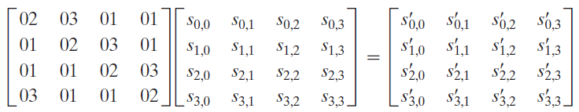
MixColumn Transformation
(Figure can be found on page 144 in textbook)
Notes:
The forward mix column transformation,
called MixColumns, operates on each column individually. Each byte of a column
is mapped into a new value that is a function of all four bytes in that column. The
transformation can be defined by the following matrix multiplication on State
(Figure 5.7b)
Each element in the product matrix is the sum of products of elements of one row
and one column. In this case, the individual additions and multiplications are
performed in GF(2⁸ ).

Slide 21
Mix Columns Rationale
Coefficients of a matrix based on a linear code with maximal distance between code words ensures a good mixing among the bytes of each column
The mix column transformation combined with the shift row transformation ensures that after a few rounds all output bits depend on all input bits
Notes:
The coefficients of the matrix in Equation (5.3) are based on a linear
code with maximal distance between code words, which ensures a good mixing
among the bytes of each column. The mix column transformation combined with
the shift row transformation ensures that after a few rounds all output bits depend
on all input bits. See [DAEM99] for a discussion.
In addition, the choice of coefficients in MixColumns, which are all {01}, { 02},
or { 03}, was influenced by implementation considerations. As was discussed, multiplication
by these coefficients involves at most a shift and an XOR. The coefficients
in InvMixColumns are more formidable to implement. However, encryption was
deemed more important than decryption for two reasons:
1. For the CFB and OFB cipher modes (Figures 6.5 and 6.6; described in Chapter 6),
only encryption is used.
2. As with any block cipher, AES can be used to construct a message authentication
code (Chapter 12), and for this, only encryption is used.

Slide 22
AddRoundKey Transformation
The 128 bits of State are bitwise XORed with the 128 bits of the round key
Operation is viewed as a columnwise operation between the 4 bytes of a State column and one word of the round key
Can also be viewed as a byte-level operation
Rationale:
Is as simple as possible and affects every bit of State
The complexity of the round key expansion plus the complexity of the other stages of AES ensure security
Notes:
In the forward add round key transformation ,
called AddRoundKey, the 128 bits of State are bitwise XORed with the 128
bits of the round key. As shown in Figure 5.5b, the operation is viewed as a columnwise
operation between the 4 bytes of a State column and one word of the round
key; it can also be viewed as a byte-level operation.
The add round key transformation is as simple as possible and affects
every bit of State . The complexity of the round key expansion, plus the complexity
of the other stages of AES, ensure security.

Slide 23
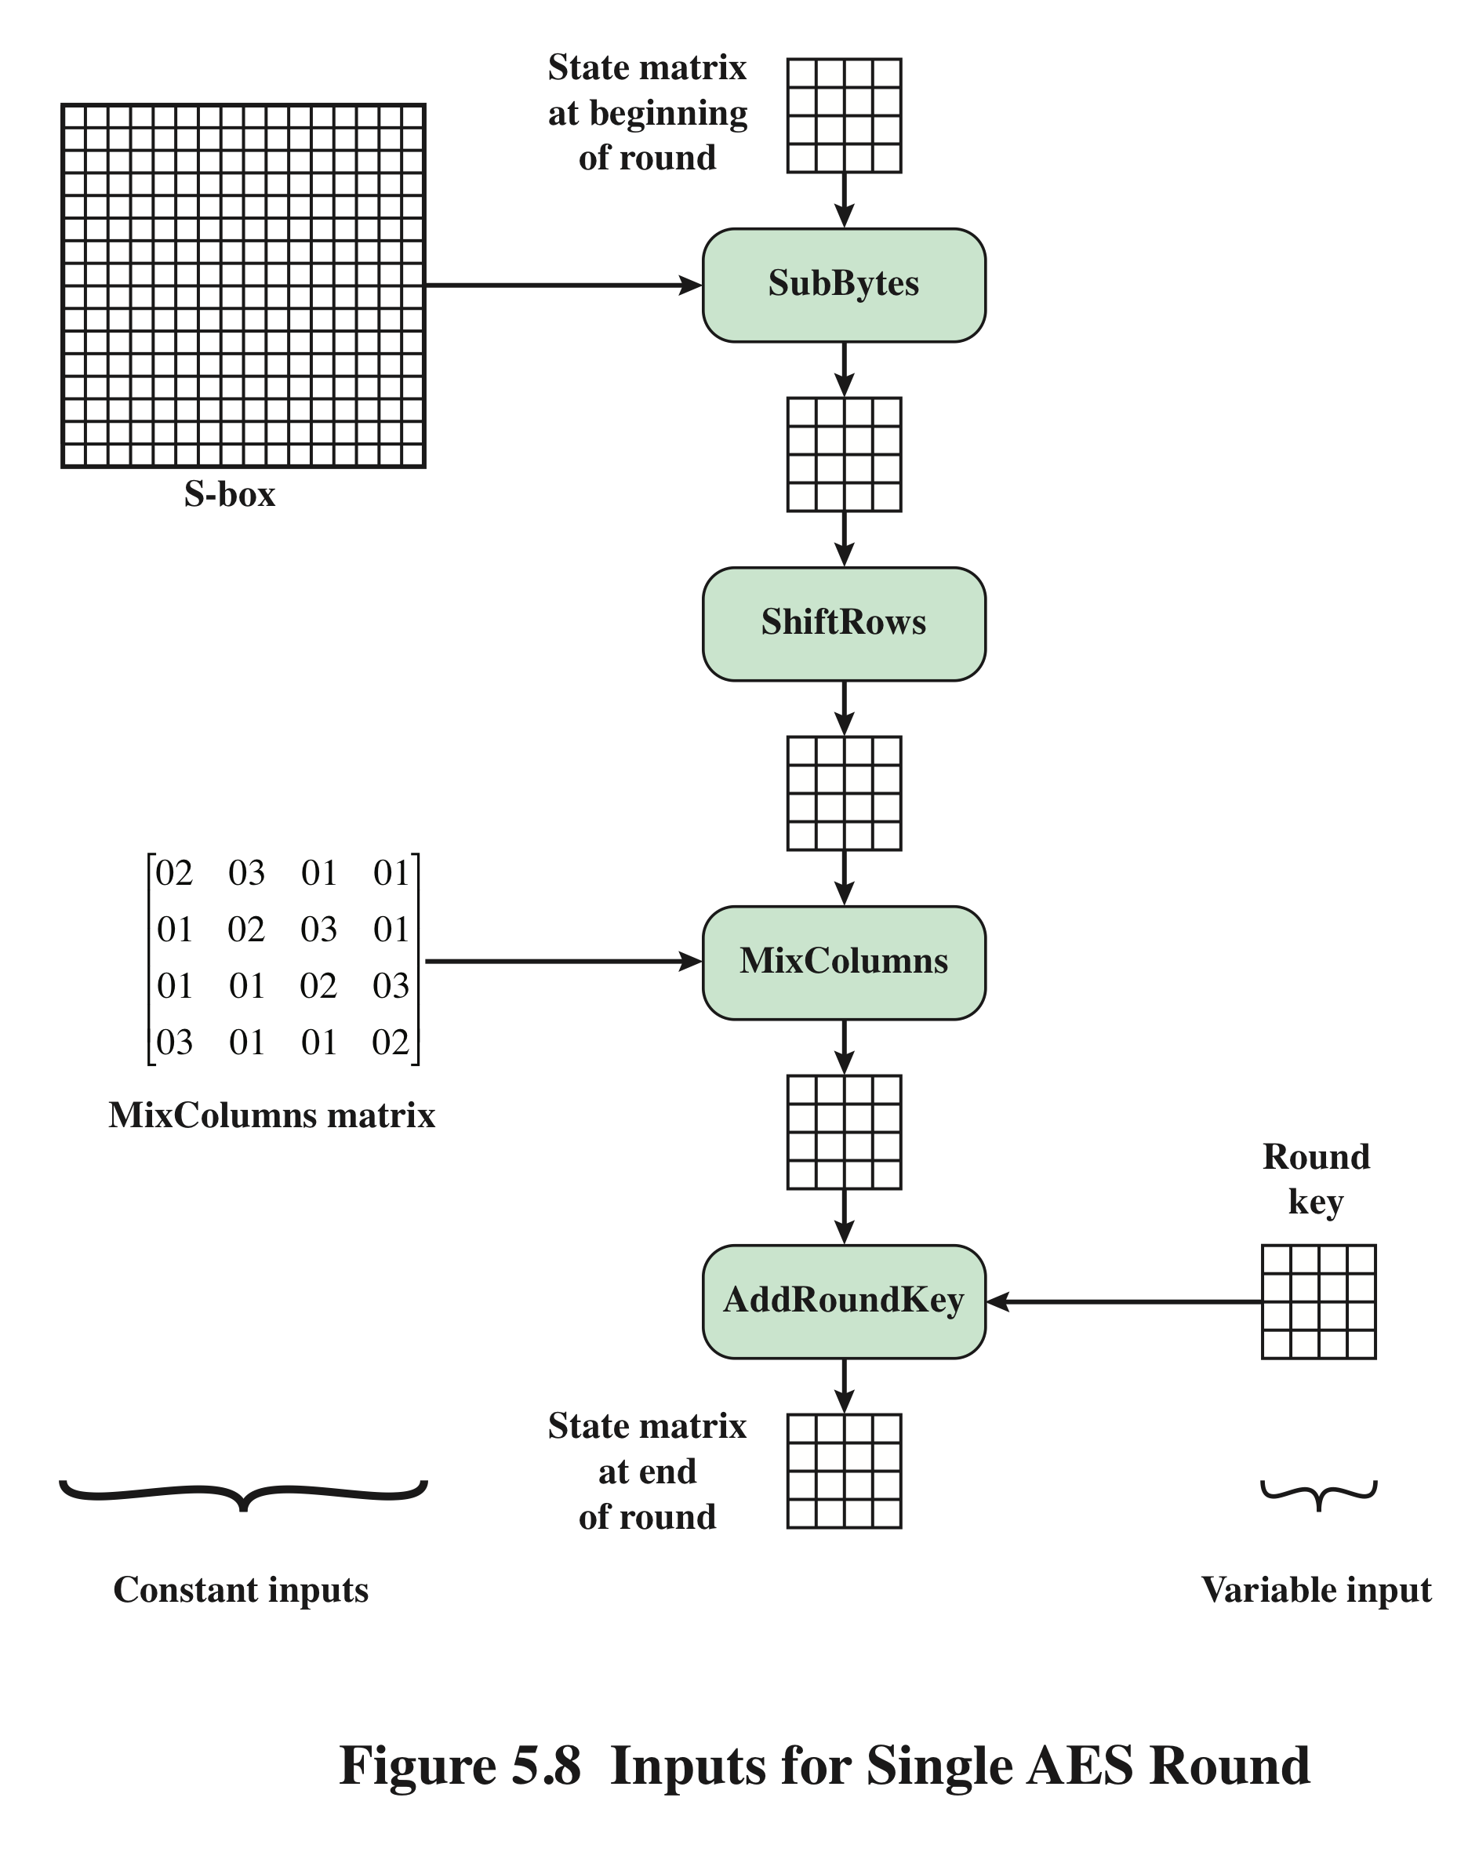
Inputs for Single AES Round
Notes:
Figure 5.8 is another view of a single round of AES, emphasizing the mechanisms
and inputs of each transformation.

Slide 24
AES Key Expansion
Takes as input a four-word (16 byte) key and produces a linear array of 44 words (176) bytes
This is sufficient to provide a four-word round key for the initial AddRoundKey stage and each of the 10 rounds of the cipher
Key is copied into the first four words of the expanded key
The remainder of the expanded key is filled in four words at a time
Each added word w[i] depends on the immediately preceding word, w[i – 1], and the word four positions back, w[i – 4]
In three out of four cases a simple XOR is used
For a word whose position in the w array is a multiple of 4, a more complex function is used
Notes:
The AES key expansion algorithm takes as input a four-word (16-byte) key and
produces a linear array of 44 words (176 bytes). This is sufficient to provide a four word
round key for the initial AddRoundKey stage and each of the 10 rounds of the
cipher. The pseudocode on the next page describes the expansion.
The key is copied into the first four words of the expanded key. The remainder
of the expanded key is filled in four words at a time. Each added word w [i]
depends on the immediately preceding word, w [i - 1], and the word four positions
back, w [i - 4]. In three out of four cases, a simple XOR is used. For a word whose
position in the w array is a multiple of 4, a more complex function is used.

Slide 25
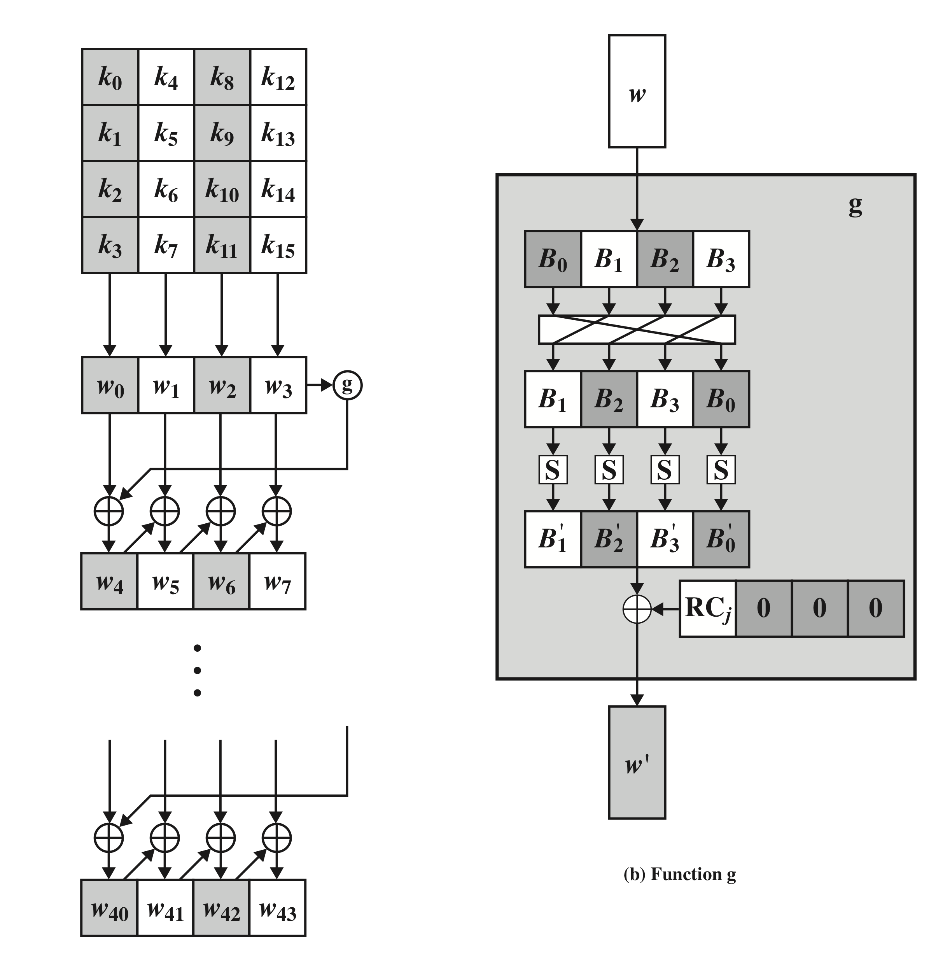
AES Key Expansion
Notes:
Figure 5.9 illustrates the generation of the expanded key, using the symbol g to represent that
complex function.

Slide 26
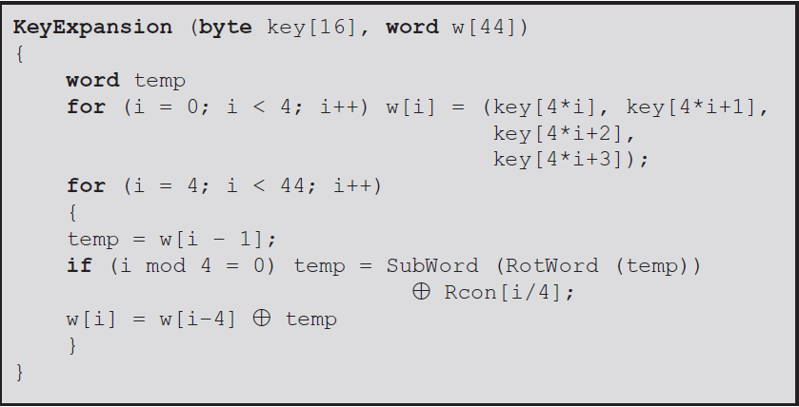
Pseudocode AES Key Expansion

Slide 27
Function g AES Key Expansion
The function g consists of the following subfunctions
RotWord performs a one-byte circular left shift on a word. This means that an input word [B0, B1, B2, B3] is transformed into [B1, B2, B3, B0].
SubWord performs a byte substitution on each byte of its input word, using the S-box (Table 6.2a).
The result of steps 1 and 2 is XORed with a round constant, Rcon[j] (only perform an XOR on the leftmost byte of the word, e.g. Rcon[j] = (RC[j], 0, 0, 0)) over the field GF(2⁸).

Slide 28
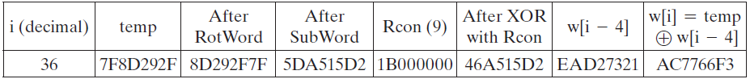
Example of function g
Suppose that the round key for round 8 is
Then the first 4 bytes (first column) of the round key for round 9 are calculated as follows:
EA D2 73 21 B5 8D BA D2 31 2B F5 60 7F 8D 29 2F

Slide 29
Key Expansion Rationale
The Rijndael developers designed the expansion key algorithm to be resistant to known cryptanalytic attacks
Inclusion of a round-dependent round constant eliminates the symmetry between the ways in which round keys are generated in different rounds
The specific criteria that were used are:
Knowledge of a part of the cipher key or round key does not enable calculation of many other round-key bits
An invertible transformation
Speed on a wide range of processors
Usage of round constants to eliminate symmetries
Diffusion of cipher key differences into the round keys
Enough nonlinearity to prohibit the full determination of round key differences from cipher key differences only
Simplicity of description
Notes:
The Rijndael developers designed the expansion key algorithm to be resistant to
known cryptanalytic attacks. The inclusion of a round-dependent round constant
eliminates the symmetry, or similarity, between the ways in which round keys are
generated in different rounds. The specific criteria that were used are [DAEM99]
• Knowledge of a part of the cipher key or round key does not enable calculation
of many other round-key bits.
• An invertible transformation [i.e., knowledge of any Nk consecutive words of
the expanded key enables regeneration of the entire expanded key (Nk = key
size in words)].
• Speed on a wide range of processors.
• Usage of round constants to eliminate symmetries.
• Diffusion of cipher key differences into the round keys; that is, each key bit
affects many round key bits.
• Enough nonlinearity to prohibit the full determination of round key differences
from cipher key differences only.
• Simplicity of description.
he authors do not quantify the first point on the preceding list, but the idea
is that if you know less than Nk consecutive words of either the cipher key or one of
the round keys, then it is difficult to reconstruct the remaining unknown bits. The
fewer bits one knows, the more difficult it is to do the reconstruction or to determine
other bits in the key expansion.

Slide 30
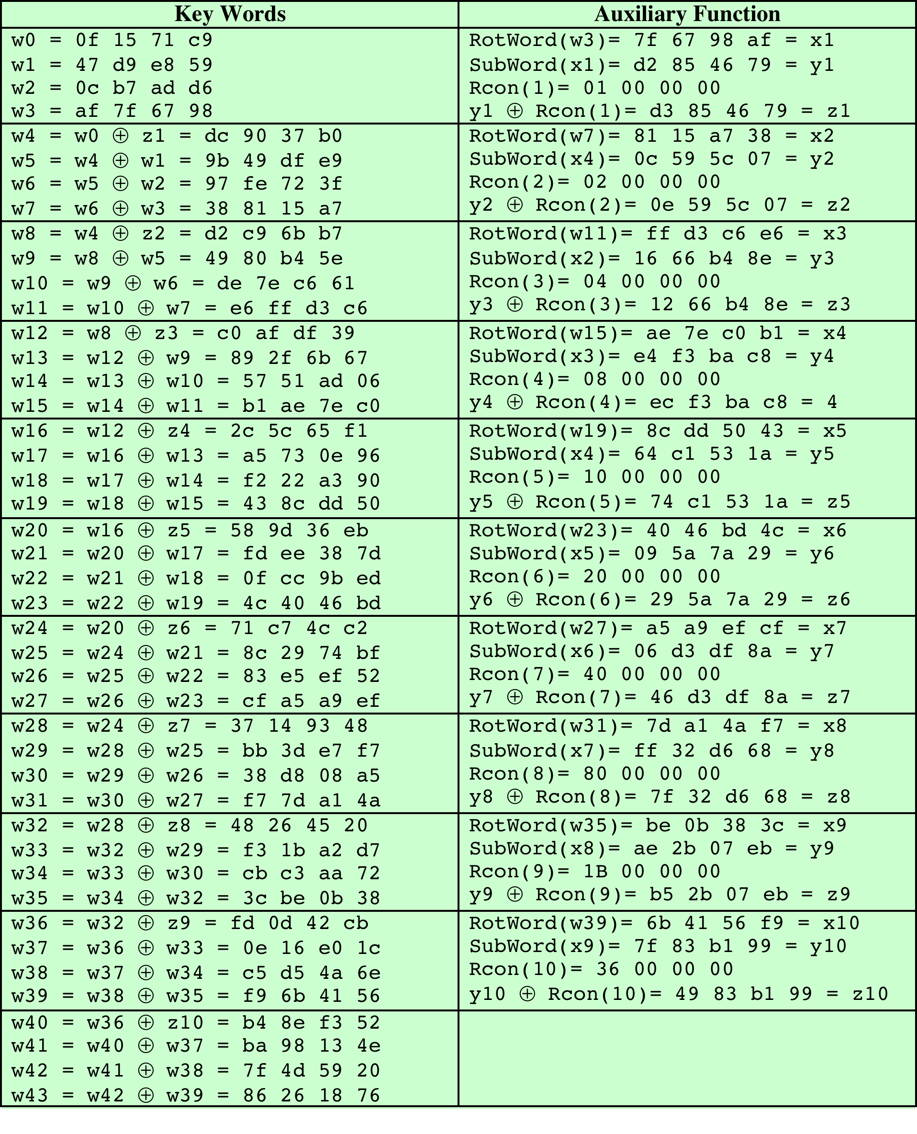
Table 5.3 AES Example Key Expansion
(Table is located on page 151
in textbook)
Notes:
Table 5.3 shows the expansion of the 16-byte key into 10 round keys. As previously
explained, this process is performed word by word, with each four-byte word occupying
one column of the word round-key matrix. The left-hand column shows
the four round-key words generated for each round. The right-hand column shows
the steps used to generate the auxiliary word used in key expansion. We begin, of
course, with the key itself serving as the round key for round 0.

Slide 31
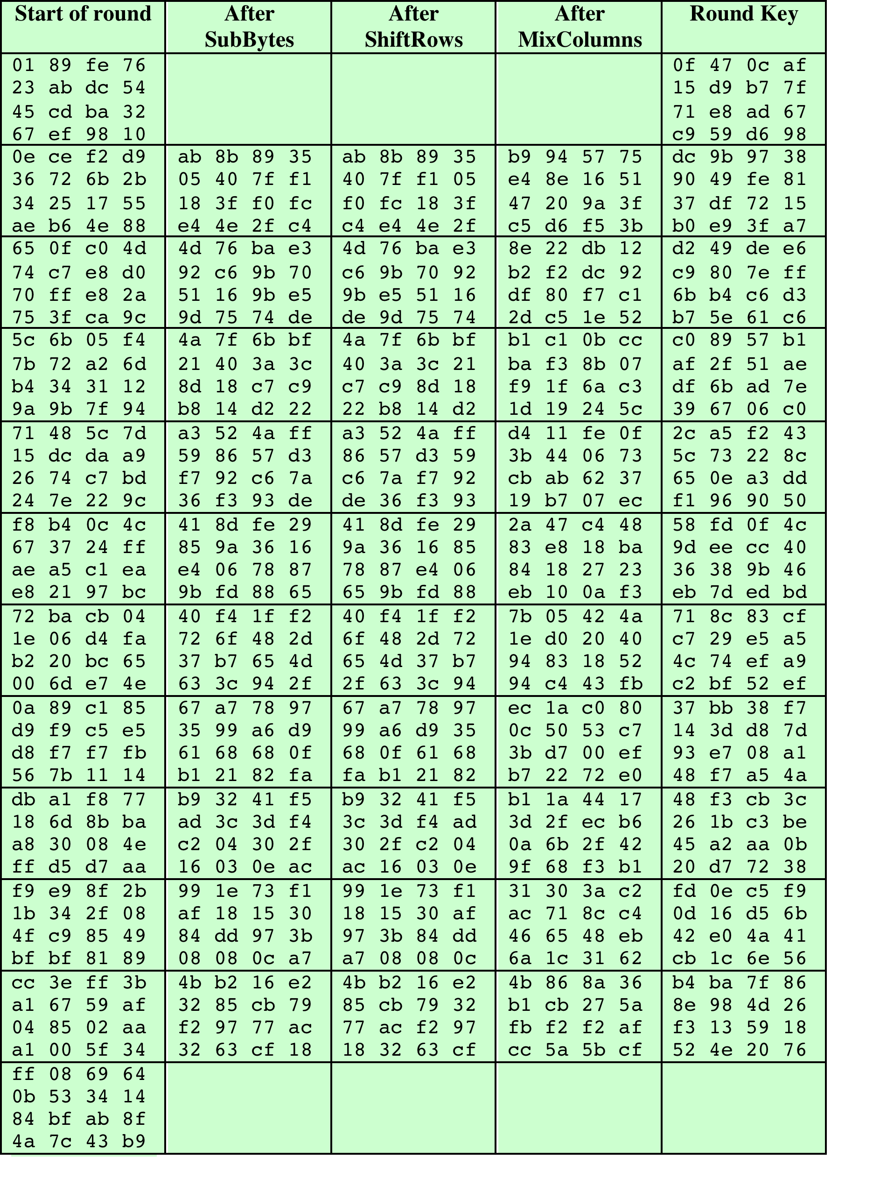
Table 5.4 AES
Example
(Table is located on page 153
in textbook)
Notes:
Next, Table 5.4 shows the progression of State through the AES encryption
process. The first column shows the value of State at the start of a round. For the
first row, State is just the matrix arrangement of the plaintext. The second, third, and
fourth columns show the value of State for that round after the SubBytes, ShiftRows,
and MixColumns transformations, respectively. The fifth column shows the round
key. You can verify that these round keys equate with those shown in Table 5.3. The
first column shows the value of State resulting from the bitwise XOR of State after
the preceding MixColumns with the round key for the preceding round.

Slide 32
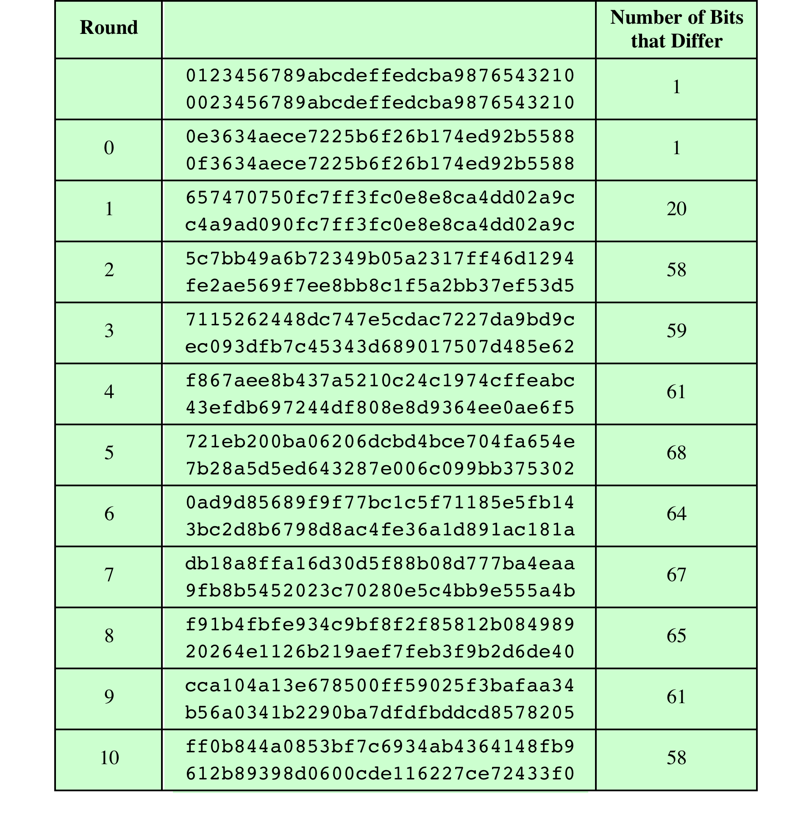
Table 5.5 Avalanche Effect
in AES: Change in Plaintext
(Table is located on page 154
in textbook)
Notes:
If a small change in the key or plaintext were to produce a corresponding small
change in the ciphertext, this might be used to effectively reduce the size of the
plaintext (or key) space to be searched. What is desired is the avalanche effect, in
which a small change in plaintext or key produces a large change in the ciphertext.
Using the example from Table 5.4, Table 5.5 shows the result when the
eighth bit of the plaintext is changed. The second column of the table shows the
value of the State matrix at the end of each round for the two plaintexts. Note
that after just one round, 20 bits of the State vector differ. After two rounds,
close to half the bits differ. This magnitude of difference propagates through
the remaining rounds. A bit difference in approximately half the positions in the
most desirable outcome. Clearly, if almost all the bits are changed, this would be
logically equivalent to almost none of the bits being changed. Put another way, if
we select two plaintexts at random, we would expect the two plaintexts to differ
in about half of the bit positions and the two ciphertexts to also differ in about
half the positions.

Slide 33
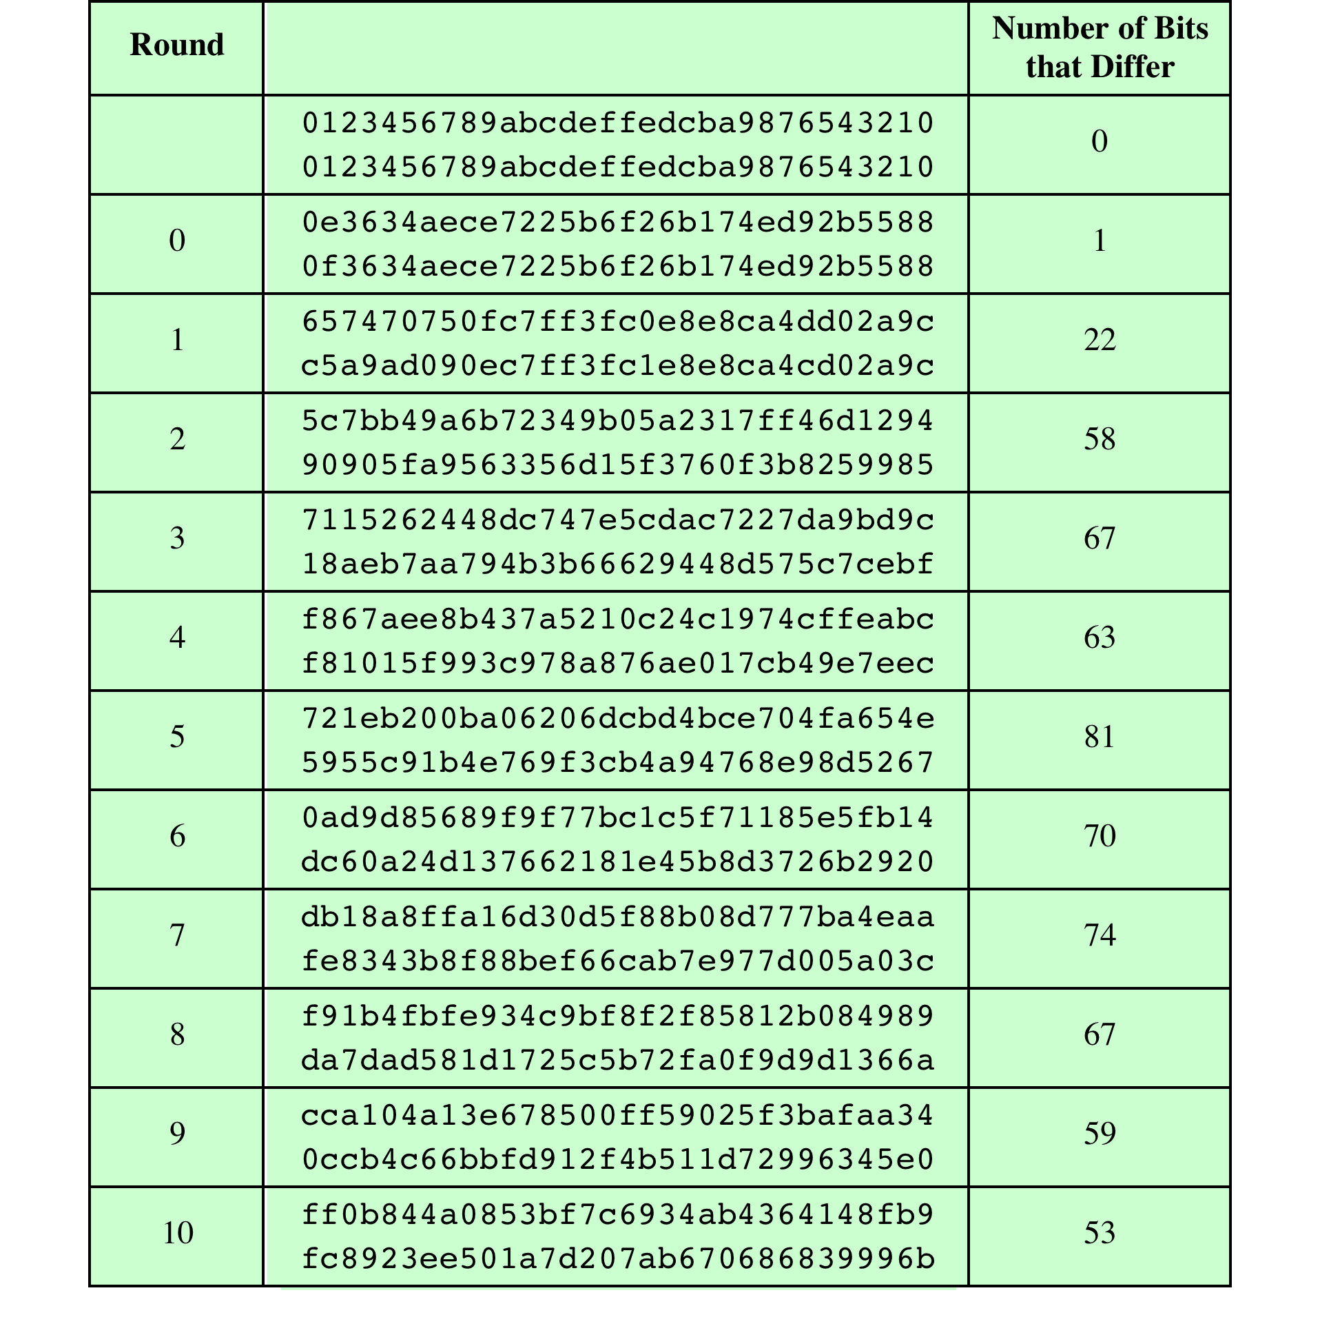
Table 5.6 Avalanche Effect
in AES: Change
in Key
(Table is located on page 155
in textbook)
Notes:
Table 5.6 shows the change in State matrix values when the same plaintext is
used and the two keys differ in the eighth bit. That is, for the second case, the key is
0e1571c947d9e8590cb7add6af7f6798. Again, one round produces a significant
change, and the magnitude of change after all subsequent rounds is roughly half
the bits. Thus, based on this example, AES exhibits a very strong avalanche effect.
Note that this avalanche effect is stronger than that for DES (Table 3.2),
which requires three rounds to reach a point at which approximately half the bits
are changed, both for a bit change in the plaintext and a bit change in the key.

Slide 34
Equivalent Inverse Cipher
AES decryption cipher is not identical to the encryption cipher
The sequence of transformations differs although the form of the key schedules is the same
Has the disadvantage that two separate software or firmware modules are needed for applications that require both encryption and decryption
Two separate changes are needed to bring the decryption structure in line with the encryption structure
The first two stages of the decryption round need to be interchanged
The second two stages of the decryption round need to be interchanged
Notes:
As was mentioned, the AES decryption cipher is not identical to the encryption
cipher (Figure 5.3). That is, the sequence of transformations for decryption differs
from that for encryption, although the form of the key schedules for encryption
and decryption is the same. This has the disadvantage that two separate software
or firmware modules are needed for applications that require both encryption and
decryption. There is, however, an equivalent version of the decryption algorithm
that has the same structure as the encryption algorithm. The equivalent version has
the same sequence of transformations as the encryption algorithm (with transformations
replaced by their inverses). To achieve this equivalence, a change in key
schedule is needed.
Two separate changes are needed to bring the decryption structure in line
with the encryption structure. As illustrated in Figure 5.3, an encryption round has
the structure SubBytes, ShiftRows, MixColumns, AddRoundKey. The standard
decryption round has the structure InvShiftRows, InvSubBytes, AddRoundKey,
InvMixColumns. Thus, the first two stages of the decryption round need to
be interchanged, and the second two stages of the decryption round need to be
interchanged.

Slide 35
Interchanging InvShiftRows and InvSubBytes
InvShiftRows affects the sequence of bytes in State but does not alter byte contents and does not depend on byte contents to perform its transformation
InvSubBytes affects the contents of bytes in State but does not alter byte sequence and does not depend on byte sequence to perform its transformation
Thus, these two operations commute and can be interchanged
Notes:
InvShiftRows affects the
sequence of bytes in State but does not alter byte contents and does not depend
on byte contents to perform its transformation. InvSubBytes affects the contents
of bytes in State but does not alter byte sequence and does not depend on byte
sequence to perform its transformation. Thus, these two operations commute and
can be interchanged.

Slide 36
Interchanging AddRoundKey and InvMixColumns
The transformations AddRoundKey and InvMixColumns do not alter the sequence of bytes in State
If we view the key as a sequence of words, then both AddRoundKey and InvMixColumns operate on State one column at a time
These two operations are linear with respect to the column input
Notes:
The transformations
AddRoundKey and InvMixColumns do not alter the sequence of bytes in State . If we
view the key as a sequence of words, then both AddRoundKey and InvMixColumns
operate on State one column at a time. These two operations are linear with respect
to the column input.

Slide 37
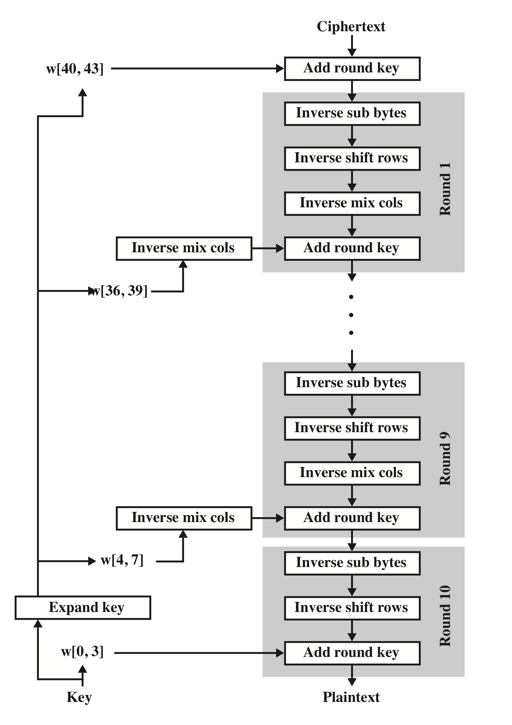
Equivalent Inverse Cipher
Notes:
Figure 5.10 illustrates the equivalent decryption algorithm.

Slide 38
Implementation Aspects
AES can be implemented very efficiently on an 8-bit processor
AddRoundKey is a bytewise XOR operation
ShiftRows is a simple byte-shifting operation
SubBytes operates at the byte level and only requires a table of 256 bytes
MixColumns requires matrix multiplication in the field GF(2⁸), which means that all operations are carried out on bytes
Notes:
The Rijndael proposal [DAEM99] provides some suggestions for efficient implementation
on 8-bit processors, typical for current smart cards, and on 32-bit processors,
typical for PCs.
AES can be implemented very efficiently on an 8-bit processor.
AddRoundKey is a bytewise XOR operation. ShiftRows is a simple byteshifting
operation. SubBytes operates at the byte level and only requires a table of
256 bytes.
The transformation MixColumns requires matrix multiplication in the field
GF(28 ), which means that all operations are carried out on bytes. MixColumns only
requires multiplication by {02} and {03}, which, as we have seen, involved simple
shifts, conditional XORs, and XORs. This can be implemented in a more efficient
way that eliminates the shifts and conditional XORs.

Slide 39
Implementation Aspects
Can efficiently implement on a 32-bit processor
Redefine steps to use 32-bit words
Can precompute 4 tables of 256-words
Then each column in each round can be computed using 4 table lookups + 4 XORs
At a cost of 4Kb to store tables
Designers believe this very efficient implementation was a key factor in its selection as the AES cipher
Notes:
The implementation described in the preceding subsection uses
only 8-bit operations. For a 32-bit processor, a more efficient implementation can
be achieved if operations are defined on 32-bit words. To show this, we first define
the four transformations of a round in algebraic form.
The developers of Rijndael believe that this compact, efficient implementation
was probably one of the most important factors in the selection of Rijndael for AES.

Slide 40
AES Rijndael Encryption Cipher Overview
Youtube Example

Slide 41
AES Rijndael Cipher - Visualization
Thanks to Abin Alichin and Youtube
Example
Scholartica Channel – some details and examples
https://www.youtube.com/watch?v=nL1ApwEXrz0

Slide 42
Summary
AES transformation functions
Substitute bytes
ShiftRows
MixColumns
AddRoundKey
AES implementation
Equivalent inverse cipher
Implementation aspects
Finite field arithmetic
AES structure
General structure
Detailed structure
AES key expansion
Key expansion algorithm
Rationale
Notes:
Chapter 5 summary.

